Slide 1
Lecture 1: A New Beginning
References, contacts, etc.
Why Study Many Body Physics?
  Basis for new Devices
  Complex Emergent Phenomena
  Describe Experiments
Complexity results from many (time, length, etc.) scales
To describe these systems, we must abandon the wave function formalism
  Build a new formalism, based upon Green functions

Slide 2
Lecture 1: A New Beginning
References, contacts, etc.
Why Study Many Body Physics?
  Basis for new Devices
  Complex Emergent Phenomena
  Describe Experiments
Complexity results from many (time, length, etc.) scales
To describe these systems, we must abandon the wave function formalism
  Build a new formalism, based upon Green functions

Slide 3
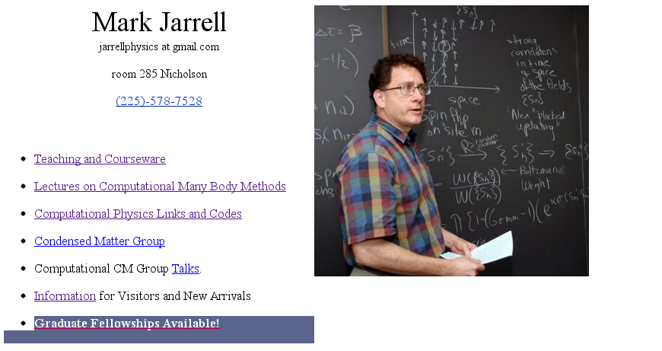

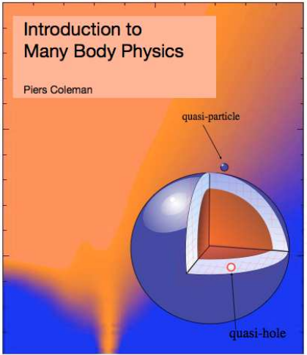
References, Contacts, etc.
www.phys.lsu.edu/~jarrell
Primary text, Introduction to Many Body Physics, by Piers Coleman (right)
http://www.physics.rutgers.edu/~coleman/mbody.html

Slide 4
Lecture 1: A New Beginning
References, contacts, etc.
Why Study Many Body Physics?
  Basis for new Devices
  Complex Emergent Phenomena
  Describe Experiments
Complexity results from many (time, length, etc.) scales
To describe these systems, we must abandon the wave function formalism
  Build a new formalism, based upon Green functions

Slide 5
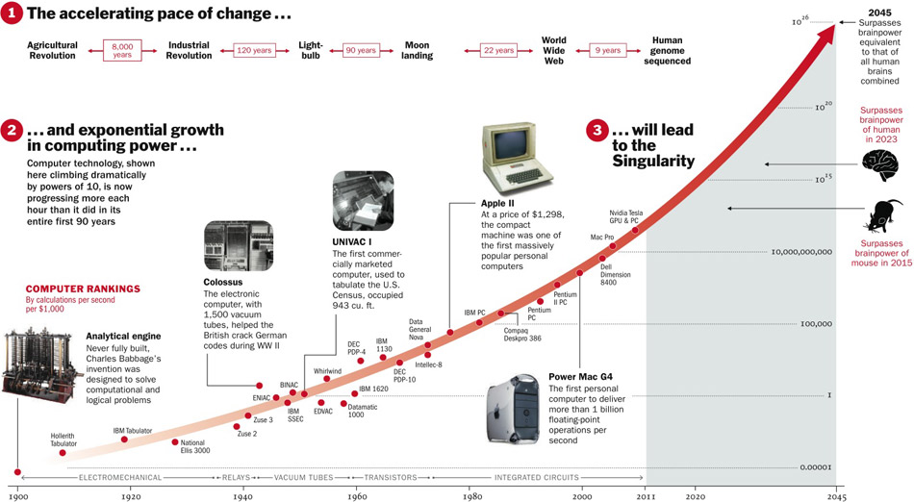
Exponential growth in computing power:
http://i.timeinc.net/time/daily/2011/1102/singularity_graphic.jpg

Slide 6
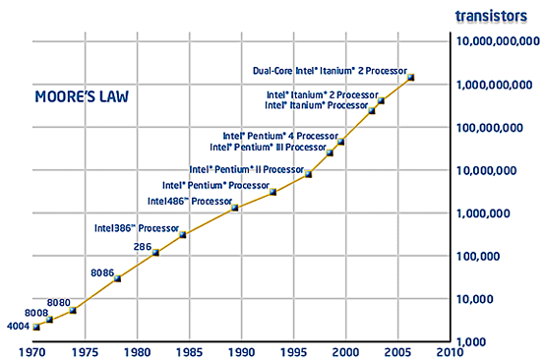
We need faster, smaller, more efficient chips
By 2020 a transistor in a chip may reach the size of a few atoms.
Electronics based on a new paradigm is needed!

Slide 7
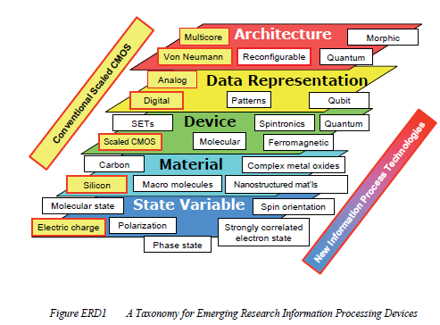
According to the 2007 ITRS, new devices will come from strongly correlated electronic materials
  Electronic memory effect from Mott transition memory
New computational state variables include:
    magnetic dipole (e.g., electron or nuclear spin state),
                molecular state
      phase state
strongly correlated electron state
quantum qubit,
photon polarization, etc
Spintronics is an example of using the new spin state variable in addition to charge
http://www.itrs.net/Links/2007ITRS/2007_Chapters/2007_ERD.pdf

Slide 8
What is spintronics? And why?
Spin-unpolarized current:
Electrons move with random spin
orientation
Spin-polarized current:
Electrons move with same spin
orientation

Slide 9
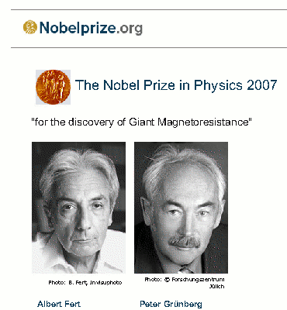
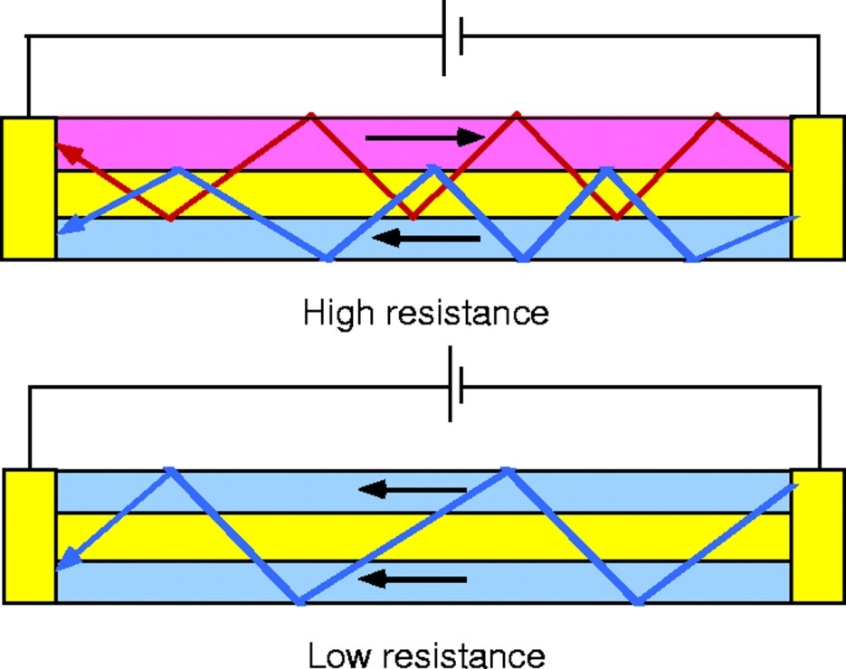
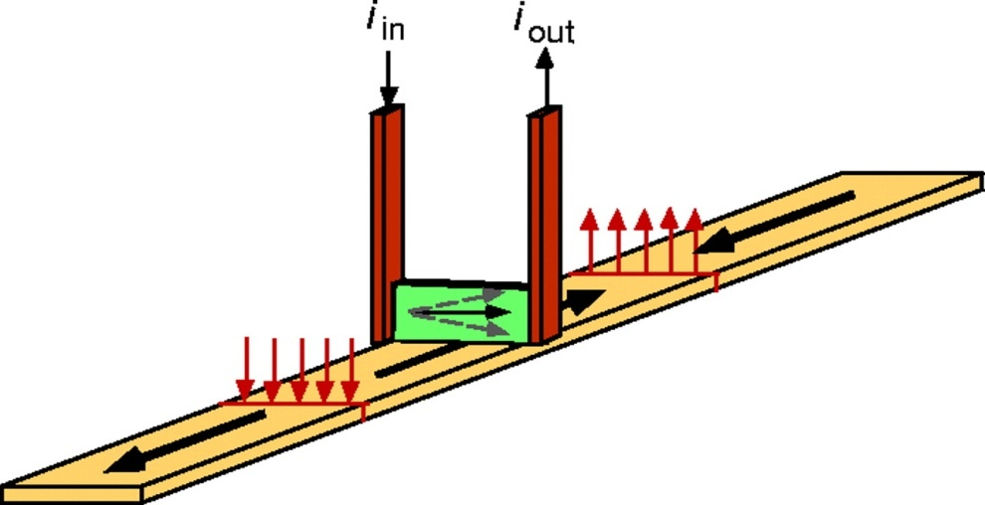
Devices based on “static” spins
Giant magneto-resistance hard-disks
GMR effect (1988)
IBM hard disk (1997)
[Prinz, Science 1998]

Slide 10
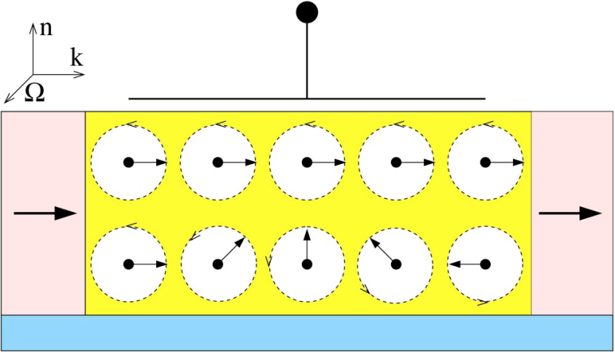
Devices based on spin-polarized currents
Spin Field Effect Transistor
Datta-Das (1990)
Spin precession due to spin-orbit interaction with spin-orbit splitting controlled by gate potential
p
p
-
-
type
type
n
n
-
-
type
type
Spin LED
-
-
-
-
-
-
-
spin
spin
H split the spin levels circularly polarized light.
+
spin
+
+
injector
injector
injector
-
-
-
-
hν
Very small spin injections!

Slide 11
Lecture 1: A New Beginning
References, conacts, etc.
Why Study Many Body Physics?
  Basis for new Devices
  Complex Emergent Phenomena
  Describe Experiments
Complexity results from many (time, length, etc.) scales
To describe these systems, we must abandon the wave function formalism
  Build a new formalism, based upon Green functions

Slide 12
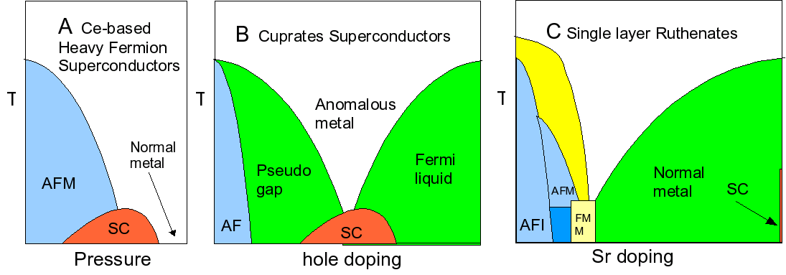
Complex Emergent Phenomena
Complex Behavior that emerges when many particle are assembled. Behavior that cannot be predicted from a complete understanding of each atom.
Complex phases (superconductivity, metals, semiconductors,…)
Competing Ground states
  E.g. Fermi liquid vs. AFM in CeIn3
  Complexity at crossover
Far more complexity in Cuprates, Ruthenates, Manganites, etc.
E. Dagotto, Complexity in Strongly Correlated Electronic Systems, Science, 309, p257-262 (2005).

Slide 13



Quantum criticality
T_{c} →0 as a function of a non-thermal control parameter
Physics near QCP driven by quantum fluctuations
QCP affects properties of a material up to surprisingly high temperatures.
Secondary order (driven by remnant fluctuations) may emerge near QCP.

Slide 14
Lecture 1: A New Beginning
References, contacts, etc.
Why Study Many Body Physics?
  Basis for new Devices
  Complex Emergent Phenomena
  Describe Experiments
Complexity results from many (time, length, etc.) scales
To describe these systems, we must abandon the wave function formalism
  Build a new formalism, based upon Green functions

Slide 15
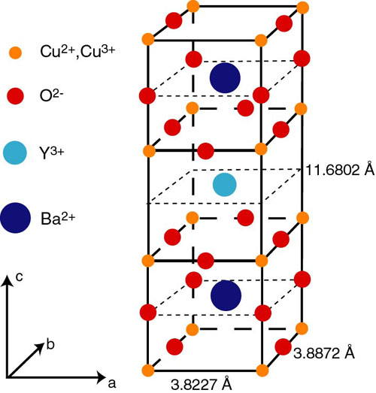
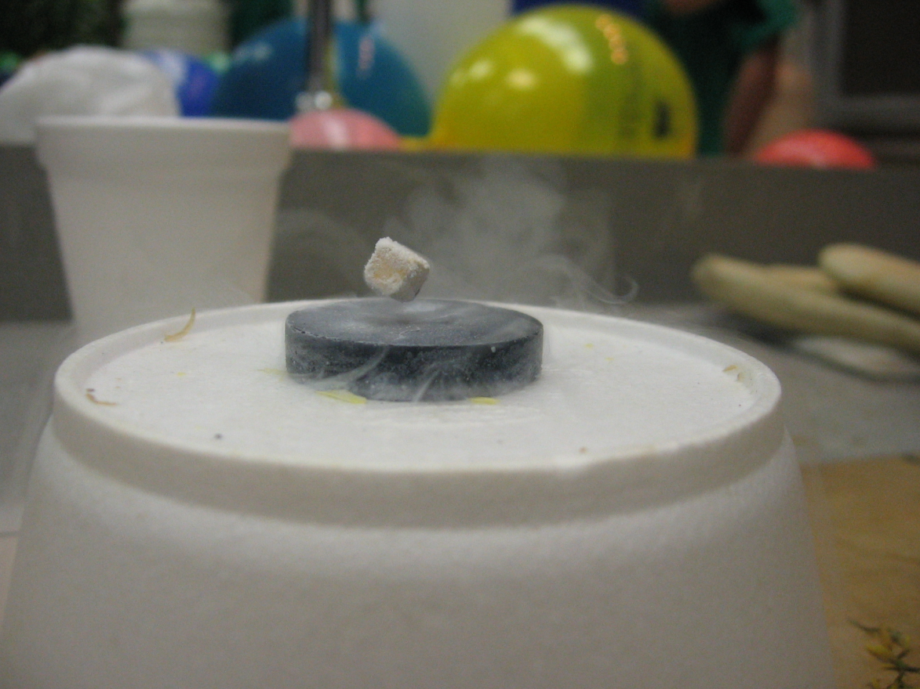
Many Length Scales
A phase transition occurs when the correlation length of the order diverges
http://apod.nasa.gov/apod/ap120312.html
10⁻⁸cm
1cm

Slide 16
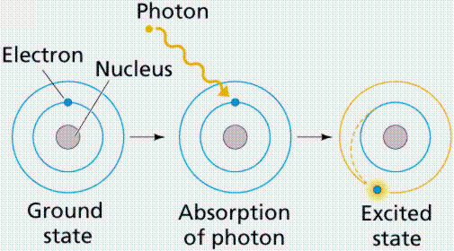
Many Time Scales
The characteristic time scale of an ordered phase is about a second
10⁻¹⁵s
1s

Slide 17
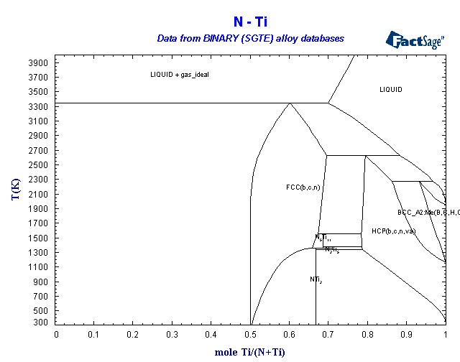
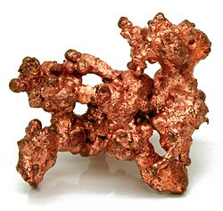
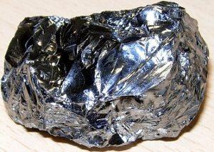
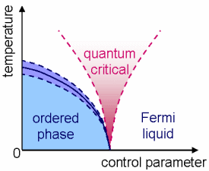
Complexity and Diverse Atomic Environments
The simplest life molecule has around 20 atomic environments
Copper
Lead
1
Atomic Environments
2
3
4

Slide 18
Lecture 1: A New Beginning
References, contacts, etc.
Why Study Many Body Physics?
  Basis for new Devices
  Complex Emergent Phenomena
  Describe Experiments
Complexity results from many (time, length, etc.) scales
To describe these systems, we must abandon the wave function formalism
  Build a new formalism, based upon Green functions

Slide 19
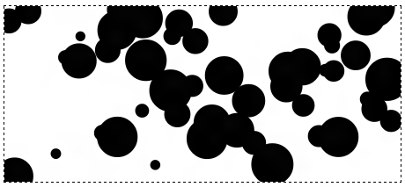


Is a Wave Function Approach still Feasible?
10²³ particles
We cannot write down a wave function of a mole of particles
Even if we could, would could calculate this wave function due to non-polynomial scaling

Slide 20
Lecture 1: A New Beginning
References, contacts, etc.
Why Study Many Body Physics?
  Basis for new Devices
  Complex Emergent Phenomena
  Describe Experiments
Complexity results from many (time, length, etc.) scales
To describe these systems, we must abandon the wave function formalism
  Build a new formalism, based upon Green functions

Slide 21

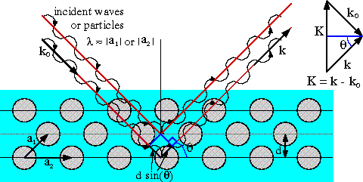
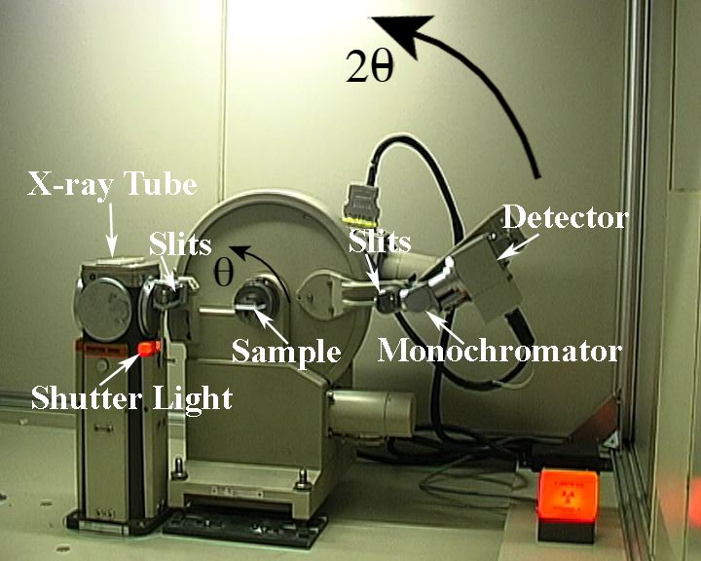
Experiments don’t measure wave functions
They measure Green functions!
Elastic scattering (energy conserving) of x-rays or neutrons comes closest
Scattering intensity proportional to the absolute square of the density

Slide 22
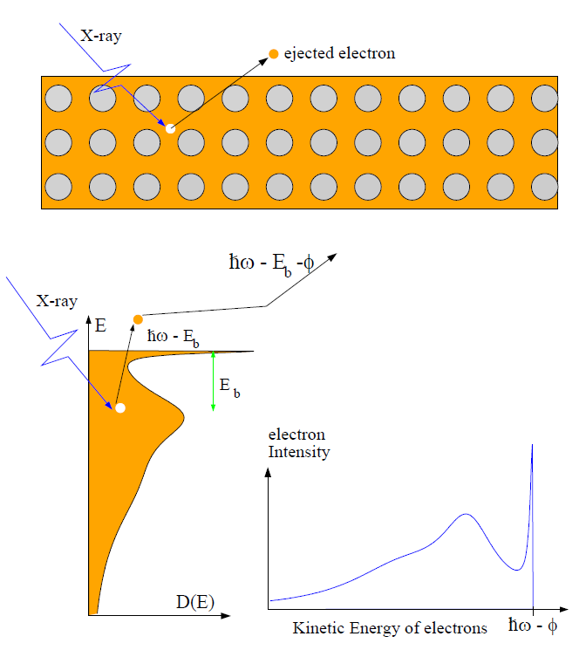

Experiments don’t measure wave functions
They measure Green functions!
Photoemission measures a Green function

Slide 23
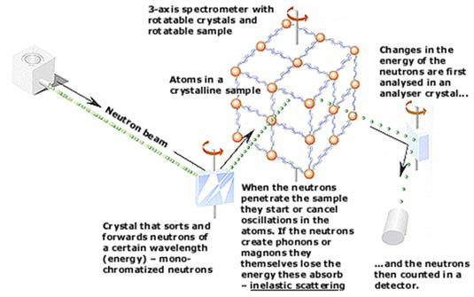
Experiments don’t measure wave functions
Neutron Scattering (inelastic)
  S(k,w)
  Scattering Probability
  A Green function

Slide 24
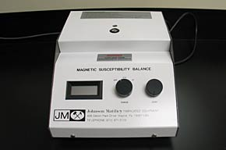
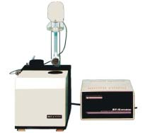

Experiments don’t measure wave functions
Magnetic Susceptibility
  A Green function

Slide 25
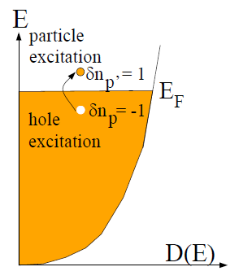
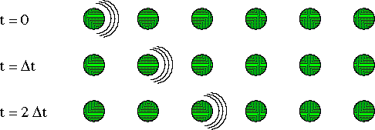
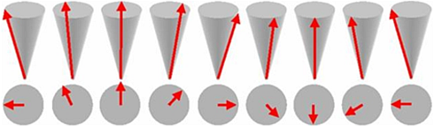
Experiments measure the “few” excitations
In a metal (left) only the electrons at the Fermi level can be excited and contribute to, e.g., the magnetic susceptibility
In a lattice, lattice excitations are few at low T, but they are responsible for inelastic neutron scattering
  Few means approximately independent
Neutrons (with a spin flip) can also scatter from magnetic waves (magnons)
Each of these elementary excitations is described by a Green function
phonons
magnons

Slide 26
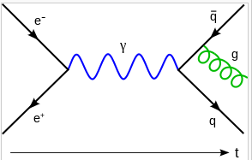
Strategy of this Course
Study Complex Emergent Phenomena
  Interesting physics
    Competing phases
    Quantum criticality
  Essential for a new generation of devices
Abandon first quantized formalism
  Green functions replace wave functions
    Describe experiments
  Study the elementary excitations of the system
    The few rather than the many
  Use a second quantized formalism of creation and annihilation of these elementary excitations
    Feynman graphs treat interactions beween ee
www.phys.lsu.edu/~jarrell

