Slide 1
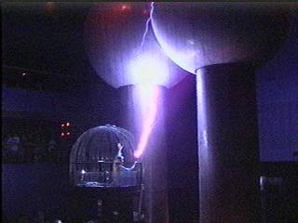
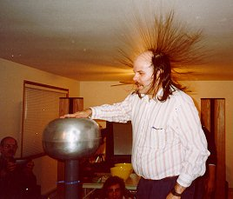
Physics 2102
Physics 2102
Gabriela González
Introduction to Electricity, Magnetism and Optics
Charles-Augustin
de Coulomb
(1736-1806)

Slide 2
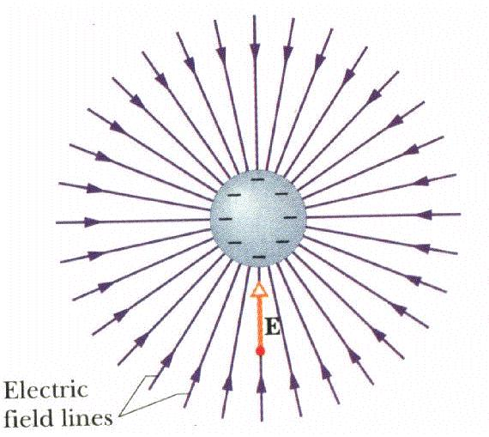
Summary of last lecture
Electric field is a vector calculated the electric force on an imaginary 1C positive charge.
Electric field lines start or end in electric charges.
When fields are strong, electric field lines get closer.
Electric field of a single charge is |E|=kq/r²
The “dipole moment” vector p has magnitude qa and direction from –ve to +ve charge.
Far from a dipole, |E|~kp/r³
http://phet.colorado.edu/en/simulation/electric-hockey

Slide 3
Computing E of a continuous charge distribution
Thus far, we have only dealt with discrete, point charges. In general, a charged object has a “continuous” charge distributed on a line, a surface or a volume. How do we calculate the electric field produced by such an object?
Approach: divide the continuous charge distribution into infinitesimally small elements
Treat each element as a POINT charge & compute its electric field
Sum (integrate) over all elements
Always look for symmetry to simplify life!
?

Slide 4
Charge Density
λ = Q/L
Useful idea: charge density
Line of charge: charge per unit length = λ
Sheet of charge: charge per unit area = σ
Volume of charge: charge per unit volume = ρ
σ = Q/A
ρ = Q/V

Slide 5
Example: Field on Bisector of Charged Rod
Uniform line of charge +Q spread over length L
What is the direction of the electric field at a point P on the perpendicular bisector?
(a) Field is 0.
(b) Along +y
(c) Along +x
P
y
a
x
Q
Choose symmetrically located elements of length dx
x components of E cancel
dx
o
dx
L

Slide 6
Example : Arc of Charge
y
Figure shows a uniformly charged rod of charge -Q bent into a circular arc of radius R, centered at (0,0).
What is the direction of the electric field at the origin?
(a) Field is 0.
(b) Along +y
(c) Along -y
x
Choose symmetric elements
x-components cancel

Slide 7
Example --Line of Charge: Quantitative
P
Uniform line of charge, length L, total charge Q
Compute explicitly the magnitude of E at point P on perpendicular bisector
Showed earlier that the net field at P is in the y direction -- let’s now compute this!
y
a
x
Q
o
L

Slide 8
Line Of Charge: Field on bisector
Distance
θ
dE
Charge
per unit length
P
a
d
dx
Q
x
o
L

Slide 9
Line Of Charge: Field on bisector
What is the field E very far away from the line (L<<a)?
Far away, any “localized” charge looks like a point charge
What is field E if the line is infinitely long (L >> a)?
Q=λL is infinite! This is not a physical situation, it is an approximation for when we are very close to the charged line (and then it “looks” infinite!).

Slide 10
Arc of Charge
y
Figure shows a uniformly charged rod of charge −Q bent into a circular arc of radius R, centered at (0,0).
Compute the direction & magnitude of E at the origin.
45⁰
x
y
dQ = λRdθ
dθ
θ
x
λ = 2Q/(πR)

Slide 11
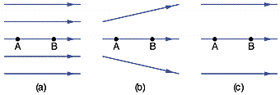
Electric field lines and forces
The drawings below represent electric field lines.
Draw vectors representing the electric force on an electron at point A, and on a proton at point B.
If the magnitude of the force on an electron at A in (a) is 1.5μN, what is the electric field at point B in each case?

Slide 12
Electric charges and fields
We work with two different kinds of problems, easily confused:
Given certain electric charges, we calculate the electric field produced by those charges.
Example: we calculated the electric field produced
by the two charges in a dipole :
Given an electric field, we calculate the forces applied by this electric field on charges that come into the field.
Example: forces on a single charge
when immersed in the field of a dipole:
(another example: force on a dipole when immersed in a uniform field)

Slide 13
Electric Dipole in a Uniform Field
Distance between charges = a
Net force on dipole = 0; center of mass stays where it is.
Net TORQUE τ: INTO page. Dipole rotates to line up in direction of E.
| τ | = 2(QE)(a/2)(sin θ) = (Qa)(E)sinθ
= |p| E sinθ
= |p x E|
The dipole tends to “align” itself with the field lines.
What happens if the field is NOT UNIFORM??
+Q
Uniform
Field
E
-Q
QE
θ
QE

