Slide 1
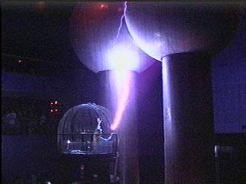
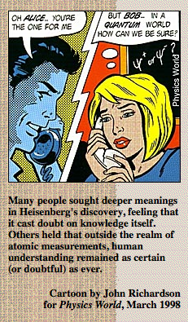
Particles and waves
Physics 2102
Gabriela González

Slide 2
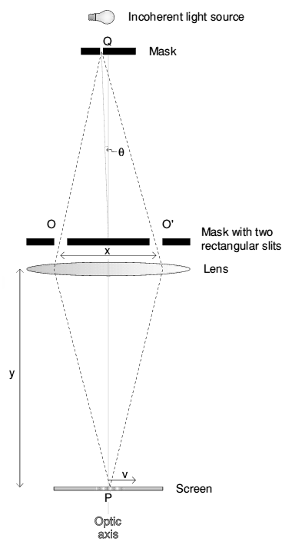
Light is a wave
We observe diffraction for waves going through apertures, and interference when waves add to each other.
Young performed his “double slit” experiment in 1801 to decide whether light was a particle (like Newton said) or a wave.

Slide 3
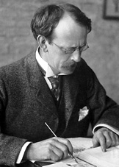
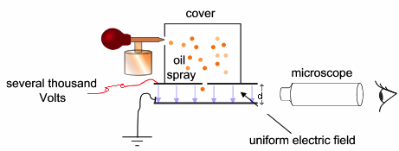
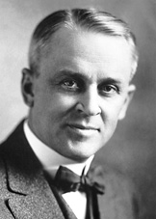
Electrons are particles
JJ Thompson, in 1897, proved that cathode rays were made of negatively charged particles: electrons !
The deflection due to an electric field proved the charge was negative.
Using an electric and magnetic field so that the beam was undeflected, he found the velocity of the beam (v=E/B, up to ~c/3 in high vacuum!)
Measuring the deflection of the beam in the absence of the magnetic field : the vertical deflection d can be measured, and is equal to d=1/2 a t² = ½ (qE/m)(L/v), so he could derive e/m : the same for all cathode rays, for all velocities: cathode rays were made of particles. Also, e/m ~1,700 larger than for a H atom: particles were “sub atomic”.
JJ Thomson won the Nobel prize for this in 1909.
The charge of the electron (the proof that charge was quantized) was measured in by Millikan with an oil-drop experiment. He won the Nobel prize for this in 1923.

Slide 4
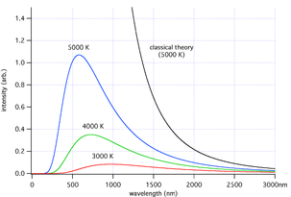
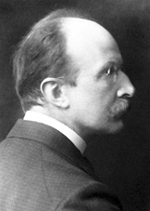
Electromagnetic energy is quantized
At room temperature, black bodies emit mostly infrared wavelengths, but as the temperature increases, black bodies start to emit visible wavelengths, appearing red, orange, yellow, white, and blue with increasing temperature. By the time an object is white, it is emitting substantial ultraviolet radiation.
Calculating the black-body curve was a major challenge in theoretical physics during the late nineteenth century. The problem was finally solved in 1901 by Max Planck as Planck's law of black-body radiation. He found a mathematical formula fitting the experimental data in a satisfactory way. To find a physical interpretation for this formula, Planck had then to assume that the energy of the oscillators in the cavity was quantized in multiple of E=hf, with h=Planck’s constant, 6.6 x 10⁻³⁴ Js.
He received the Nobel prize in 1918, "in recognition of the services he rendered to the advancement of Physics by his discovery of energy quanta"
Planck’s Nobel lecture:
“There is in particular one problem whose exhaustive solution could provide considerable elucidation. What becomes of the energy of a photon after complete emission? Does it spread out in all directions with further propagation in the sense of Huygens' wave theory, so constantly taking up more space, in boundless progressive attenuation? Or does it fly out like a projectile in one direction in the sense of Newton's emanation theory?”

Slide 5
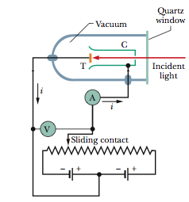
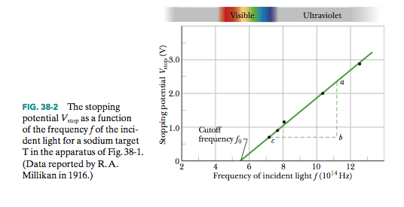
Light is a particle?
Incident light makes the target T emit electrons, collected in a conductor C and producing a current I. If there is a voltage V applied, electrons “slow down” until the voltage is large enough to stop them, at a voltage V_{stop.} This voltage is independent of the intensity of the source, but proportional to the frequency of the source, only if frequency is larger than a minimum cut-off frequency :
K_{max}= eV_{stop} = hf – Φ
Φ = “work function” depends on target material
h = Planck’s constant independent of target material
Einstein proposed in 1905 that light beams were made of photons, with quantized energy E = hf and quantized momentum p = E/c = h f/c = h/λ (but no mass!) Einstein received the Nobel prize for this in 1921.

Slide 6
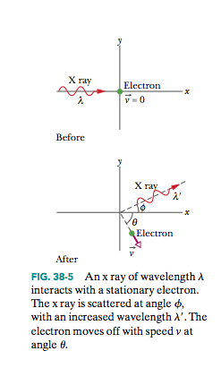
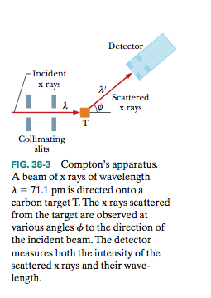
Compton scattering
Electromagnetic waves have momentum, so photons do too.
We can have “collisions” between photons (EM waves) and particles, and use conservation of energy and momentum to calculate the shift in the photon’s wavelength:
h/m_{e}c=2.42 pm = Compton wavelength for an electron

Slide 7
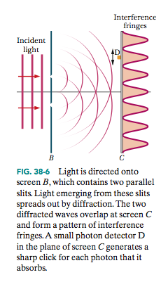
But light was a wave!?
A probability wave!
This is “Quantum Mechanics”, with equations for the “wave function” of particles and fields.

Slide 8
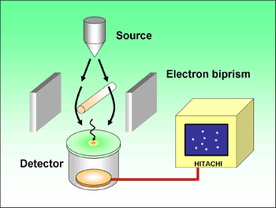
Electron waves?
http://www.hitachi.com/rd/research/em/doubleslit.html

Slide 9
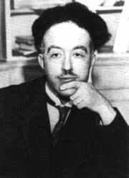
Wave-particle duality
deBroglie hypothesis: every particle with momentum p has an associated wave with λ = h/p
His 1920 PhD thesis won the Nobel prize in 1929
Thus to describe the properties of matter as well as those of light, waves and corpuscles have to be referred to at one and the same time. The electron can no longer be conceived as a single, small granule of electricity; it must be associated with a wave and this wave is no myth; its wavelength can be measured and its interferences predicted. It has thus been possible to predict a whole group of phenomena without their actually having been discovered. And it is on this concept of the duality of waves and corpuscles in Nature, expressed in a more or less abstract form, that the whole recent development of theoretical physics has been founded and that all future development of this science will apparently have to be founded.
1 keV electron: p=(2mK) ^{½} =1.7 x 10⁻²³ kg m/s and λ = h/p = 39 pm
1 keV photon: p=E/c =5.3 x 10⁻²⁵ kg m/s and λ = h/p = 1.2 nm
30 m/s, 3000 kg car (~60mph, 6,000 lb): p = mv = 9 x 10⁴ kg m/s and = 7.4 x 10 ⁻³⁹ m
Planck’s length: where gravity and quantum mechanics coexist.

Slide 10
Heisenberg’s uncertainty principle
Can we know WHERE a photon is?
Only if we don’t know its momentum.
Heisenberg’s uncertainty principle:
Heisenberg, 1932 Nobel lecture:
“The accuracy with which the location of a particle can be ascertained and the accuracy with which its momentum can simultaneously be known, there is a relation according to which the product of the probable errors in the measurement of the location and momentum is invariably at least as large as Planck’s constant divided by 2π. “
Heisenberg’s microscope:
http://www.aip.org/history/heisenberg/

