Slide 1
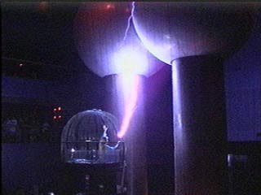
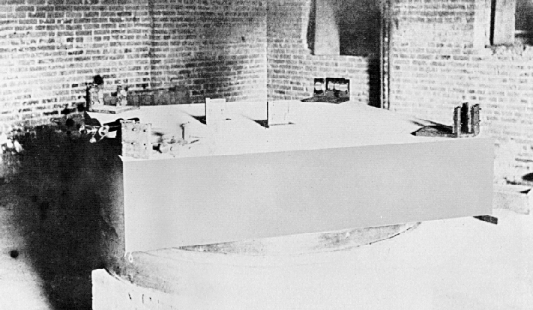
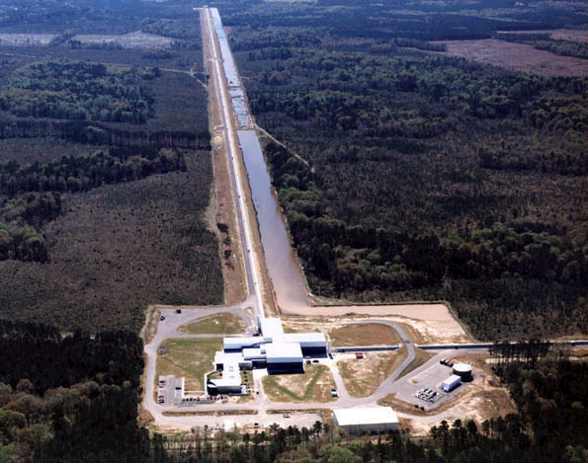
Interference
Physics 2102
Gabriela González

Slide 2
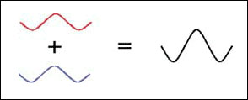
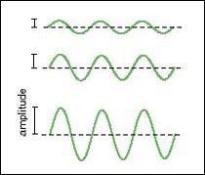
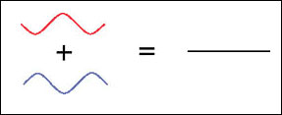
Light is a wave
When two beams of light combine, we can have constructive or destructive “interference.”
http://www.colorado.edu/physics/2000/applets/fourier.html

Slide 3
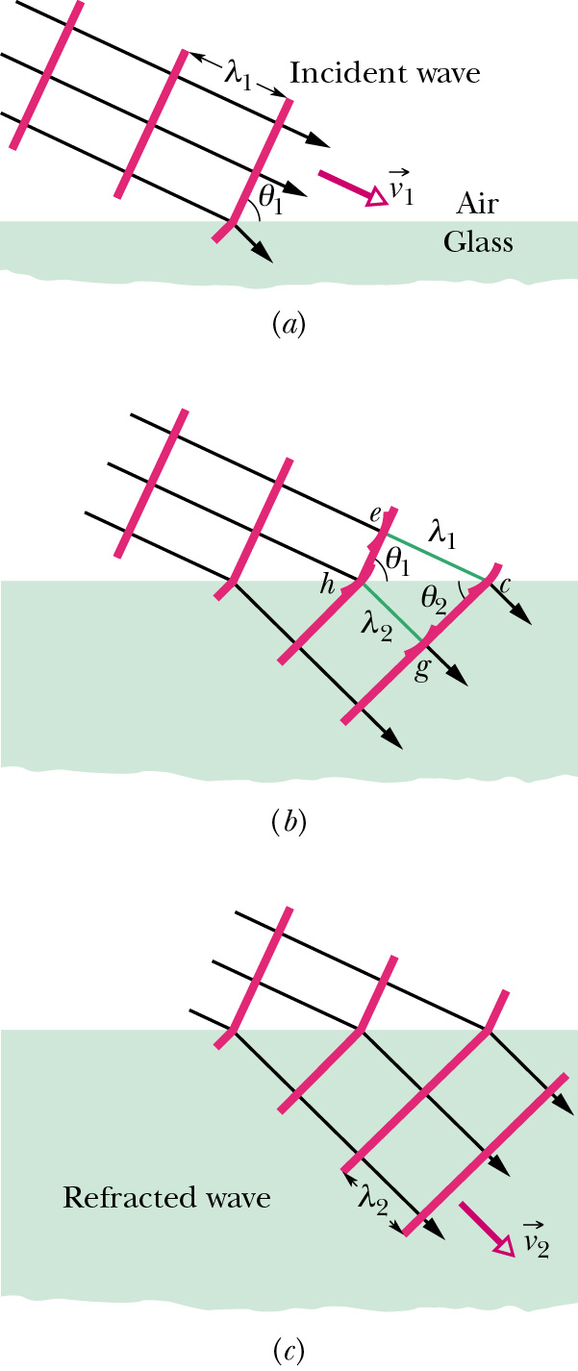
Reflection and refraction laws
The light travels more slowly in more dense media:
v=c/n (n = index of refraction)
Since the period T is the same, the wavelength has to change (v=λ/T)
Snell’s law!
Wavelength:
Frequency:

Slide 4
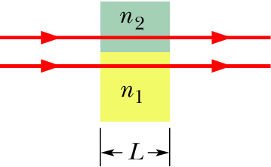
Interference: example
A red light beam with wavelength λ=0.625μm travels through glass (n=1.46) a distance of 1mm. A second beam, parallel to the first one and originally in phase with it, travels the same distance through sapphire (n=1.77).
How many wavelengths are there of each beam inside the material?
In glass, λ_{g}=0.625μm/1.46= 0.428 μm and N_{g}=L/ λ_{g}=2336.45
In sapphire, λ_{s}=0.625μm/1.77= 0.353 μm (UV!) and N_{s}=L/ λ_{s}=2832.86
What is the phase difference in the beams when they come out?
The difference in wavelengths is N_{s}-N_{g}=496.41. Each wavelength is 360º, so ΔN=496.41 means Δφ=ΔNx360º=0.41x360º=148º
How thick should the glass be so that the beams are exactly out of phase at the exit? (destructive interference!)
ΔN=L/ λ_{s}− L/ λ_{g}= (L/ λ)(n₂-n₁)=0.31 (L/ λ)=m+1/2
A thickness L=(m+0.5) 2.02 μm would make the waves OUT of phase.
For example, 1.009 mm = 499.5 x 2.02 μm makes them come OUT of phase, and 1.010 mm = 500.0 x 2.02 μm makes them IN phase.

Slide 5
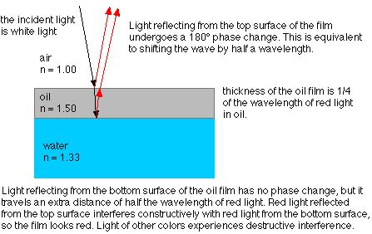
Thin film interference:
The patterns of colors that one sees
in oil slicks on water or in bubbles
is produced by interference of the
light bouncing off the two sides of
the film.
To understand this we
need to discuss the
phase changes that
occur when a wave
moves from one medium
to the another where the
speed is different. This
can be understood with
a mechanical analogy.

Slide 6
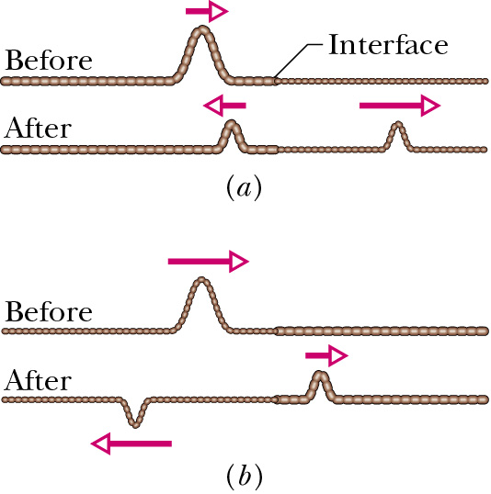
Reflection, refraction and changes of phase:
Consider a transverse pulse moving in a rope, that reaches a juncture
with another rope of different density. A reflected pulse is generated.
The reflected pulse is on the same side of
the rope as the incident one if the speed of
propagation in the rope of the right is
faster than on the left.
The reflected pulse is on the opposite side
of the rope if the speed of propagation in the
right is slower than on the left.
The extreme case of no speed on the right corresponds to a rope
anchored to a wall.
If we have a wave instead of a pulse “being on the opposite side of
the rope” means 180 degrees out of phase, or one-half wavelength
out of phase.

Slide 7
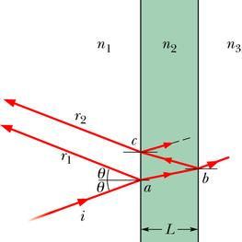
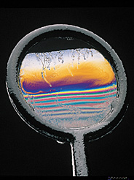
Interference: thin films
Phase with respect to incident beam:
r₁: φ₁ = 180º (if n₂>n₁)
φ₁ = 0º (if n₂<n₁)
r₂: φ₂ = 2n₂L/λ + 180º (if n₃>n₂)
φ₁ = 2n₂L/λ (if n₃<n₂)
if we have air-oil-water (or air),
Constructive interference → 2n₂L/λ = (2m+1)π
Destructive interference → 2n₂L/λ = 2m π

Slide 8
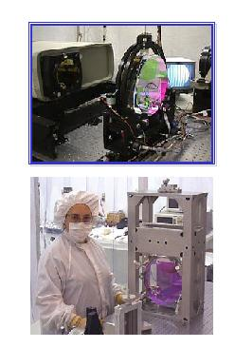
Example: mirror coatings
To make mirrors that reflects light of only a given wavelength, a coating of a specific thickness is used so that there is constructive interference of the given wavelength. Materials of different index of refraction are used, most commonly MgFe₂ (n=1.38) and CeO₂ (n=2.35), and are called “dielectric films”. What thickness is necessary for reflecting IR light with λ=1064nm?
First ray: Δφ=180deg=π
Second ray: Δφ=2L(2π/(λ/n))=π
=> L= λ_{Ceo2}/4=(λ/n)/4=113nm
Third ray? If wafer has the same thickness (and is of the same material), Δφ=4L(2π/(λ/n)=2π: destructive!
n=2.35
n=1.38
Choose MgFe2 wafer so that
Δφ=(2n₁L₁+2n₂L₂) (2π/λ)= π+ 2n₂L₂ (2π/λ)=3π
=> L₂= λ/2n₂ = 386 nm
We can add more layers to keep reflecting the light, until no light is transmitted: all the light is either absorbed or reflected.

Slide 9
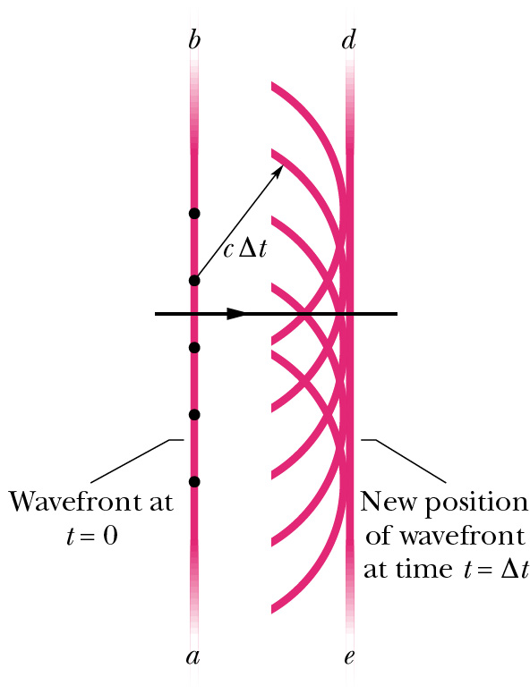
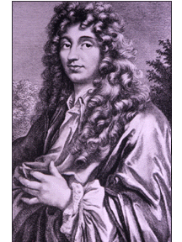
Huygen’s principle
All points in a wavefront serve as point sources of spherical secondary waves.
After a time t, the new
wavefront will be the tangent to all the resulting spherical waves.
Christian Huygens
1629-1695

Slide 10
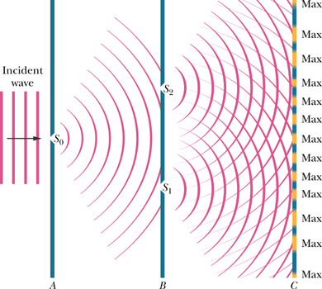
Young’s double slit experiment

Slide 11
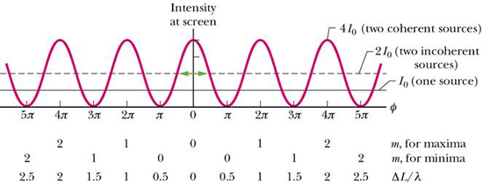
Young’s double slit experiment
Path difference: ΔL=d sin θ
Bright fringe: ΔL=mλ = d sin θ
Dark fringe: ΔL=(m+1/2)λ = d sin θ
The intensity on the screen is I/I₀=4cos²φ/2 with φ=(2πd/λ)sinθ

Slide 12
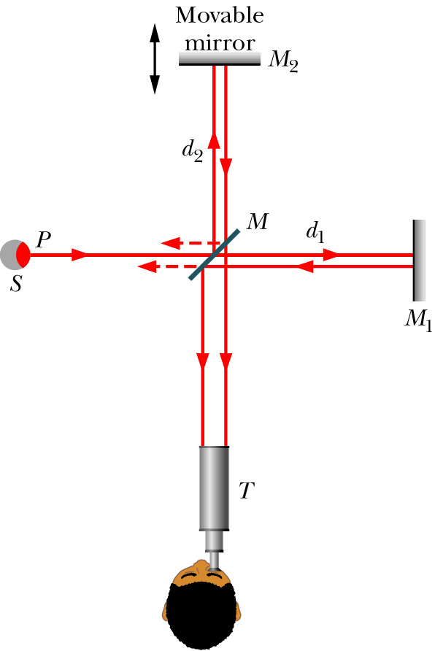
Michelson interferometers:
As we saw in the previous example, interference is a spectacular way of measuring small distances (like the thickness of a soap bubble), since we are able to resolve distances of the order of the wavelength of the light (for instance, for yellow light, we are talking about 0.5 of a millionth of a meter, 500nm). This has therefore technological applications.
In the Michelson interferometer, light from a source (at the left, in the picture) hits a semi-plated mirror. Half of it goes through to the right and half goes upwards. The two halves are bounced back towards the half plated mirror, interfere,
and the interference can be seen by the observer at the bottom. The observer will see light if the two distances travelled d₁ and d₂ are equal, and will see darkness if they differ by half a wavelength.
Einstein’s messengers (einsteinsmessengers.org)

Slide 13
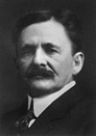
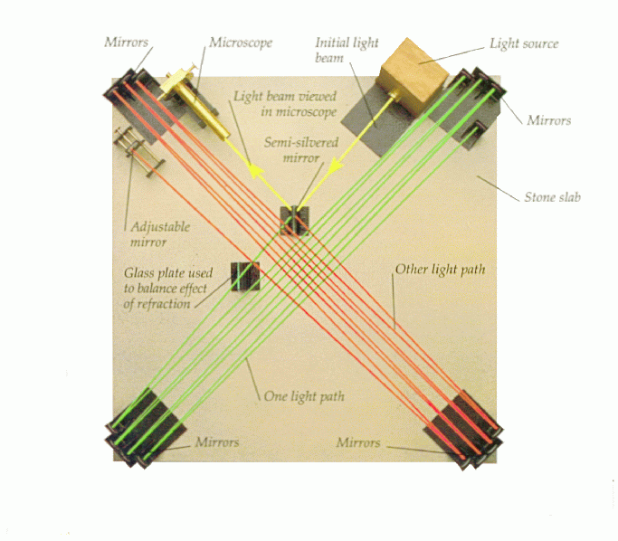
Michelson-Morley experiment
Michelson won the Nobel prize in 1907, "for his optical precision instruments and the spectroscopic and metrological investigations carried out with their aid"
"The interpretation of these results is that there is no displacement of the interference bands. ... The result of the hypothesis of a stationary ether is thus shown to be incorrect." (A. A. Michelson, Am. J. Sci, 122, 120 (1881))

Slide 14
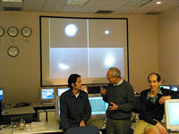
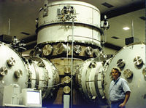
The largest Michelson interferometer in the world is in Livingston, LA,
in LSU owned land (it is operated by a project funded by the National Science Foundation run by Caltech and MIT, and LSU collaborates in the project).
Mirrors are suspended with wires and will move
detecting ripples in
the gravitational field due to astronomical events.
http://www.ligo-la.caltech.edu

Slide 15
http://www.amnh.org/sciencebulletins/?sid=a.f.gravity.20041101&src=l
American Museum of Natural History
Science Bulletins
Gravity: Making Waves

Slide 16
Examples

Slide 17
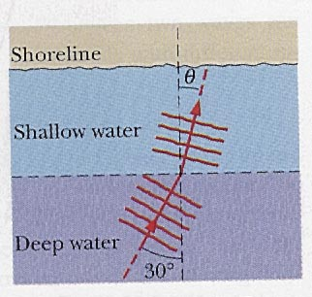
Example
Ocean waves moving at a speed of 4.0m/s are approaching a beach at an angle of 30o to the normal. The water depth changes abruptly near the shore, and the wave speed there drops to 3.0m/s. Close to the beach, what is the direction of wave motion?
Refraction index is (inversely) related to wave speed:
n₂/n₁=v₁/v₂=4/3
Snell’s law: n₂sinθ₂=n₁sinθ₁
θ₂=asin((n₁/n₂)sinθ₁)
=asin(.75sin(30º))
=22º

Slide 18
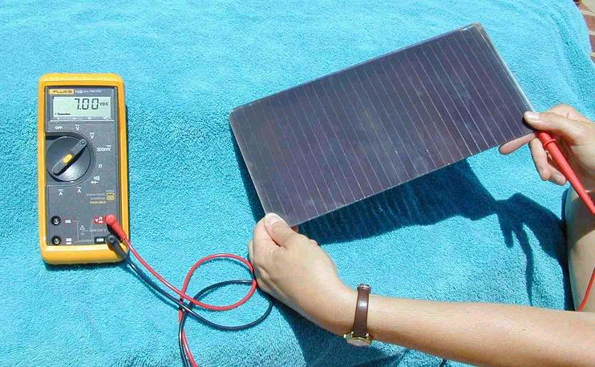
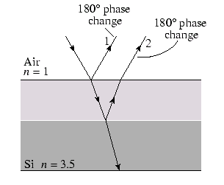
Example: Solar panels
Semiconductors such a silicon are used
to build solar cells. They are coated
with a transparent thin film, whose
index of refraction is 1.45, in order to
minimize reflected light. If the index of
refraction of silicon is 3.5, what is the minimum width of the coating
that will produce the least reflection at a wavelength of 552nm?
Both rays undergo 180 phase changes at
reflection, therefore for destructive
interference (no reflection), the distance
travelled (twice the thickness) should be
equal to half a wavelength in the coating
n=1.45

Slide 19
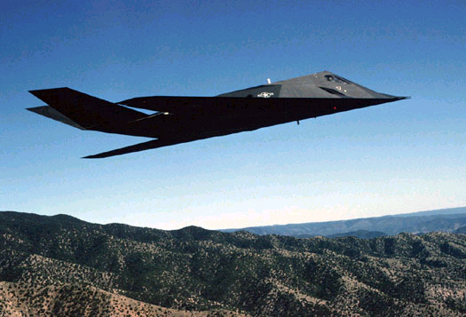
Example: the stealth planes
Radar waves have a wavelength of 3cm.
Suppose the plane is made of metal
(speed of propagation=0, n is infinite and
reflection on the polymer-metal surface
therefore has a 180 degree phase change).
The polymer has n=1.5. Same calculation as in previous example
gives,
On the other hand, if one coated a plane with the same polymer
(for instance to prevent rust) and for safety reasons wanted to maximize
radar visibility (safety!), one would have

