Slide 1
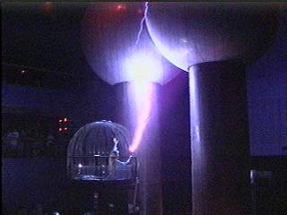
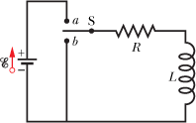
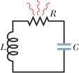
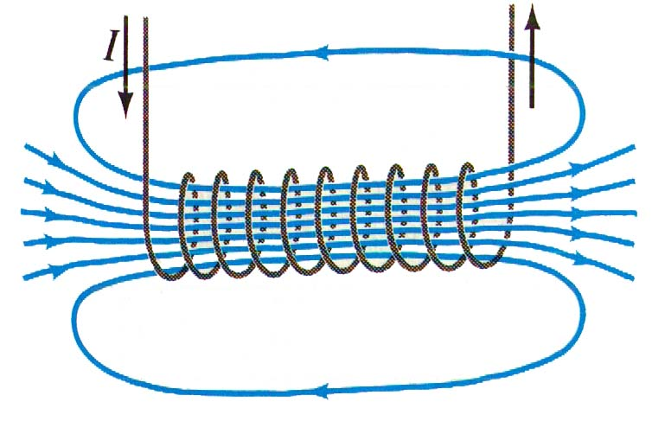
Physics 2102
Physics 2102
Gabriela González
Exam review
Inductors, EM oscillations

Slide 2
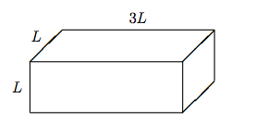
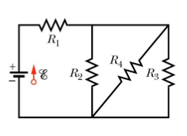
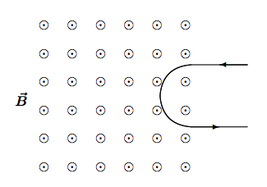
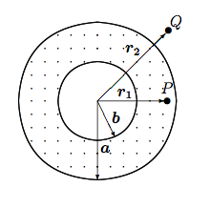
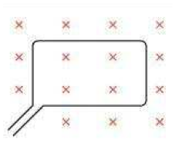
Exam review
Q1: 75.7
P1: 61.6
Q2: 67.2
Q3: 79.2
P2: 58.2
P3:52.2

Slide 3
Inductors
Inductance definition: L=NΦ_{Β}/I
Solenoid inductance: L=μ₀n²Al
Induced emf (voltage) across an inductor is E=−L di/dt
In an RL circuit, we can “charge” the inductor with a battery until there is a constant current, or “discharge” the inductor through the resistor. Time constant is L/R.
An inductor stores magnetic potential energy: U_{B}=Li²/2
Energy density stored in a magnetic field is u_{B}=B²/2μ₀

Slide 4
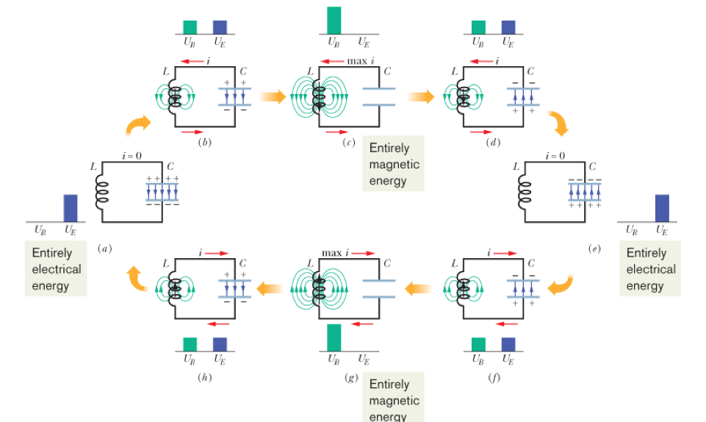
EM oscillations
An LC combination produces an electrical oscillator, the natural frequency of oscillator is ω=1/√LC
Total energy in circuit is conserved: switches between energy stored in capacitor (electric energy) and in inductor (magnetic energy).
If a resistor is included in the circuit, the total energy decays (is dissipated by R).
i(t)

