Slide 1
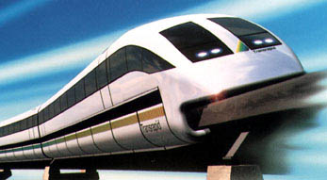
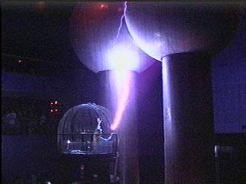
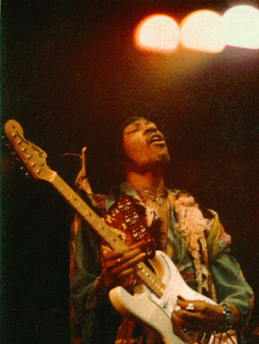
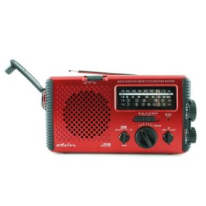
Physics 2102
Physics 2102
Gabriela González
Faraday’s law

Slide 2
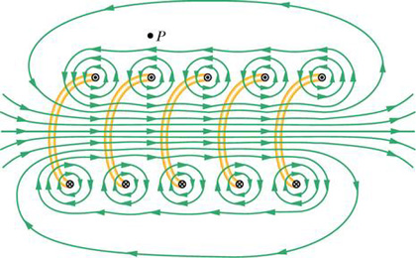
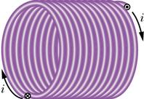
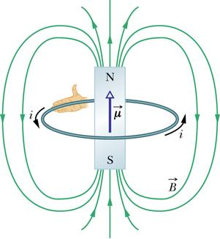
Solenoids, dipoles
An electrical current produces a magnetic field.
μ=NiA

Slide 3
Faraday’s Law
A magnetic field can create a en electrical current too!
If we define magnetic flux, similar to definition of electric flux, but for an open surface with an edge:
n
B
dA
Then a time varying magnetic FLUX creates an induced EMF, and thus an electrical current if the edge is a wire!:
Take note of the MINUS sign!!
The induced EMF acts in such a way that it OPPOSES the change in magnetic flux (“Lenz’s Law”).

Slide 4
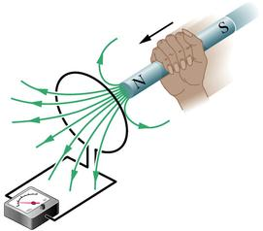
Example
When the N pole approaches the loop, the flux “into” the loop (“downwards”) increases
The loop can “oppose” this change if a current were to flow clockwise, hence creating a magnetic flux “upwards.”
So, the induced EMF is in a direction that makes a current flow clockwise.
If the N pole moves AWAY, the flux “downwards” DECREASES, so the loop has a counter clockwise current!

Slide 5
Example
n
A closed loop of wire encloses an area of 1 m² in which in a uniform magnetic field exists at 30⁰ to the PLANE of the loop. The magnetic field is DECREASING at a rate of 1T/s. The resistance of the wire is 10 Ω.
What is the induced current?
30⁰
Is it …clockwise or …counterclockwise?

Slide 6
Example
3 loops are shown.
B = 0 everywhere except in the circular region where B is uniform, pointing out of the page and is increasing at a steady rate.
Rank the 3 loops in order of increasing induced EMF.
(a) III, II, I
(b) III, (I & II are same)
(c) ALL SAME.
I
II
III
Just look at the rate of change of ENCLOSED flux
III encloses no flux and it does not change.
I and II enclose same flux and it changes at same rate.

Slide 7
Example : the Generator
A square loop of wire of side L is rotated at a uniform frequency f in the presence of a uniform magnetic field B as shown.
Describe the EMF induced in the loop.
L
B
B
θ

Slide 8
Example
An infinitely long wire carries a constant current i as shown
A square loop of side L is moving towards the wire with a constant velocity v.
What is the EMF induced in the loop when it is a distance R from the loop?
R
L
x
v
L
Choose a “strip” of width dx located as shown.
Flux thru this “strip”

Slide 9
Example (continued)
R
L
x
v
What is the DIRECTION of the induced current?
Magnetic field due to wire points INTO page and gets stronger as you get closer to wire
So, flux into page is INCREASING
Hence, current induced must be counter clockwise to oppose this increase in flux.

Slide 10
Some interesting applications
MagLev train relies on Faraday’s Law: currents induced in non-magnetic rail tracks repel the moving magnets creating the induction;
result: levitation!
Guitar pickups also use Faraday’s Law -- a vibrating string modulates the flux through a coil hence creating an electrical signal at the same frequency.

Slide 11
Faraday’s law: Eddy Currents
A non-magnetic (e.g. copper, aluminum) ring is placed near a solenoid.
What happens if:
There is a steady current in the solenoid?
The current in the solenoid is suddenly changed?
The ring has a “cut” in it?
The ring is extremely cold?

Slide 12
Another Experimental Observation
Drop a non-magnetic pendulum (copper or aluminum) through an inhomogeneous magnetic field
What do you observe? Why? (Think about energy conservation!)
Pendulum had kinetic energy
What happened to it?
Isn’t energy conserved??
N
S

Slide 13
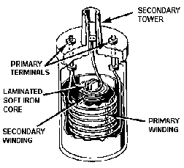
Example : the ignition coil
The gap between the spark plug in a combustion engine needs an electric field of ~10⁷ V/m in order to ignite the air-fuel mixture. For a typical spark plug gap, one needs to generate a potential difference > 10⁴ V!
But, the typical EMF of a car battery is 12 V. So, how does a spark plug work??
spark
12V
Breaking the circuit changes the current through “primary coil”
Result: LARGE change in flux thru secondary -- large induced EMF!
The “ignition coil” is a double layer solenoid:
Primary: small number of turns -- 12 V
Secondary: MANY turns -- spark plug
http://www.familycar.com/Classroom/ignition.htm

