Slide 1
GW Detectors noise and sensitivity

Slide 2
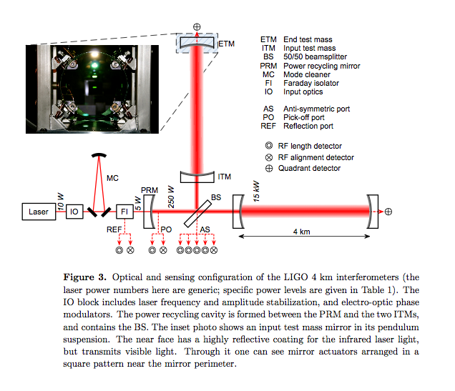
LIGO detectors
Rep. Prog. Phys. 72 (2009) 076901 arXiv:0711.3041

Slide 3
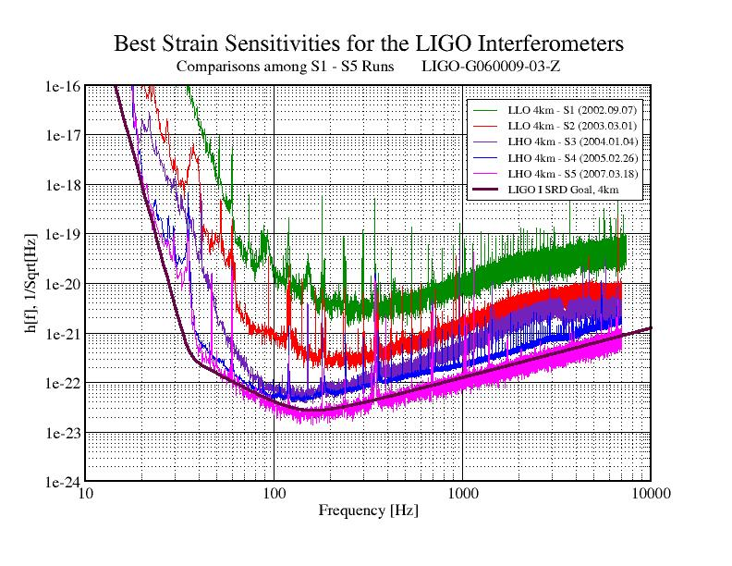
Sensitivity progress

Slide 4
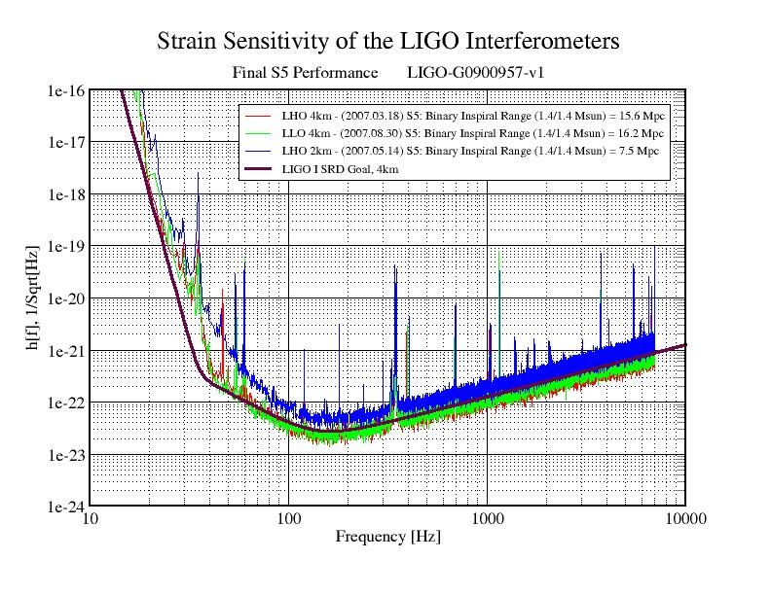

Slide 5
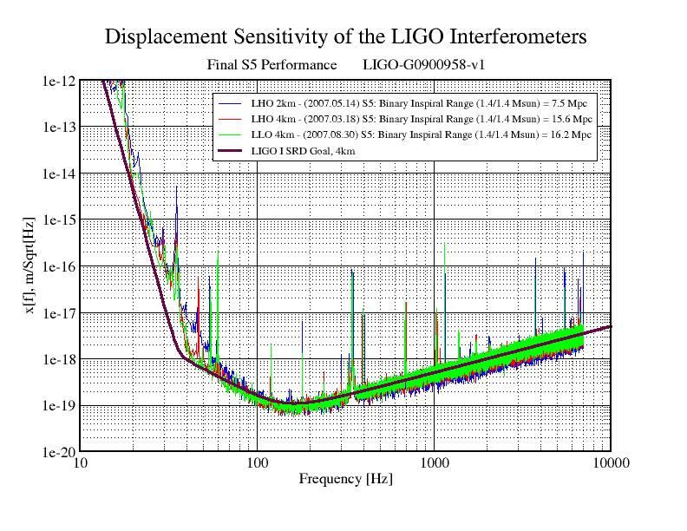

Slide 6
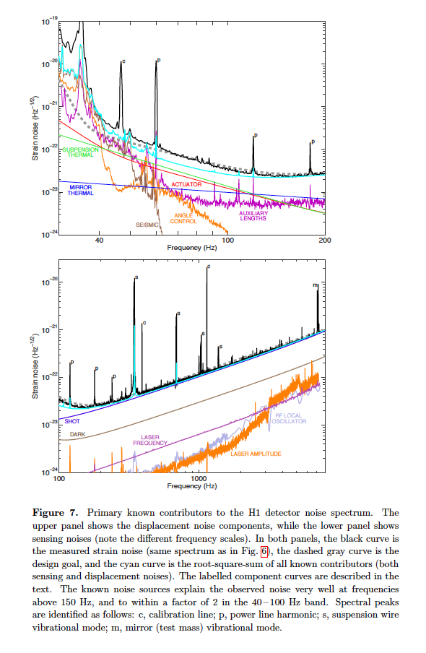
Rep. Prog. Phys. 72 (2009) 076901 arXiv:0711.3041

Slide 7
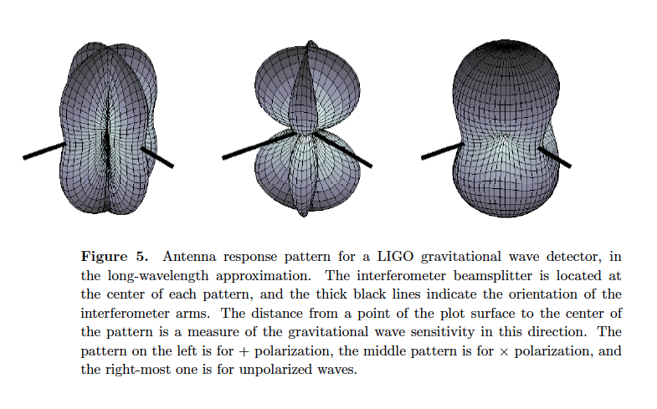
“Antenna pattern”
“peanut”

Slide 8
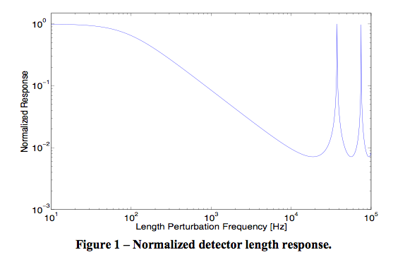
LIGO high frequency sensitivity
“FSR” (free spectral range) 37.5 kHz
Class. Quantum Grav. 25 (2008) 184017

Slide 9
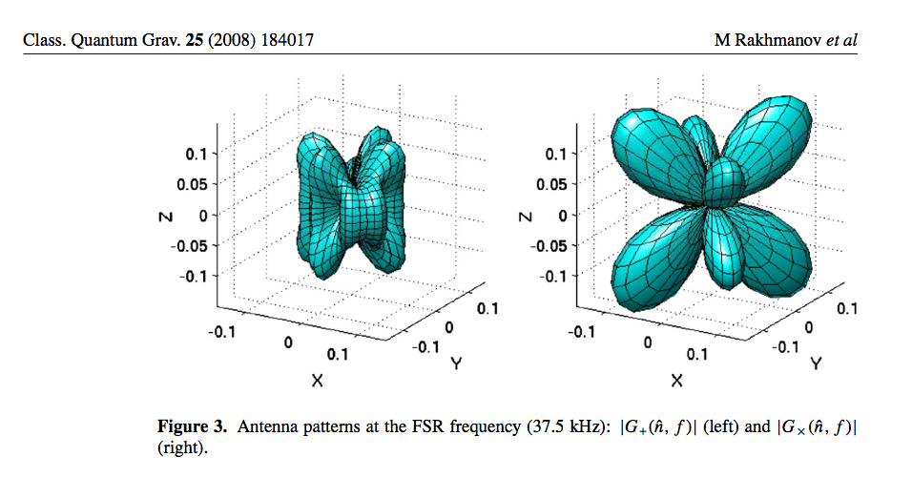
Antenna pattern at FSR

Slide 10
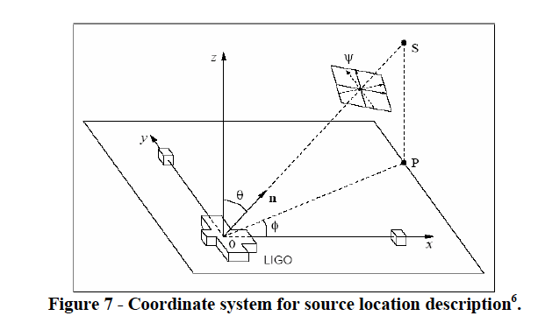
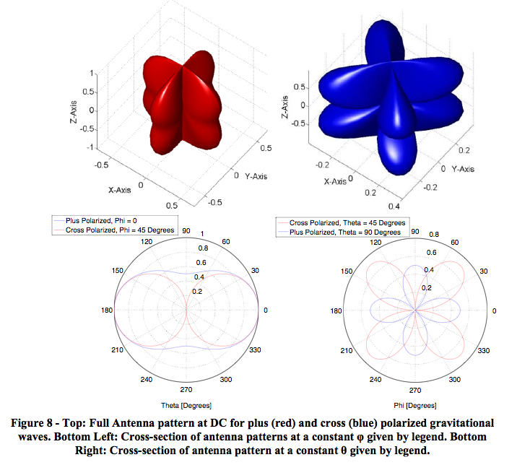
Directional sensitivity

Slide 11
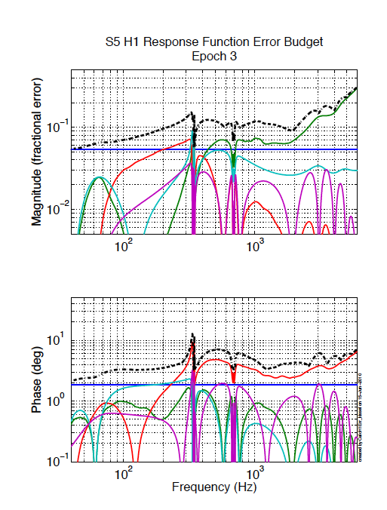
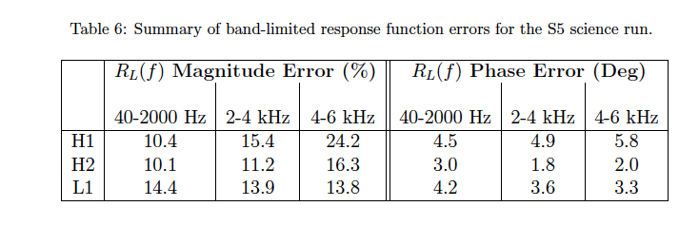
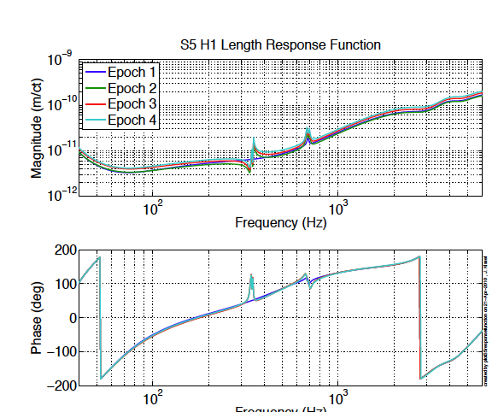
LIGO calibration
Nucl. Instrum. Meth. A624 (2010) 223 arXiv:1007.3973

Slide 12
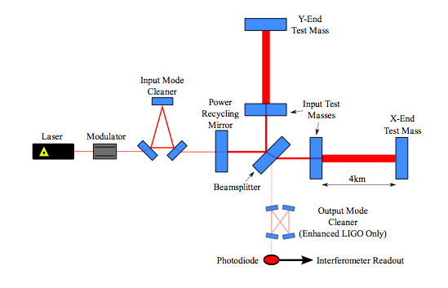
Enhanced LIGO detectors
Notes:
Sensitivity equivalent to measuring the distance to the nearest star (Proxima Centauri, 4.22 light years distant) to better than 10 microns!

Slide 13
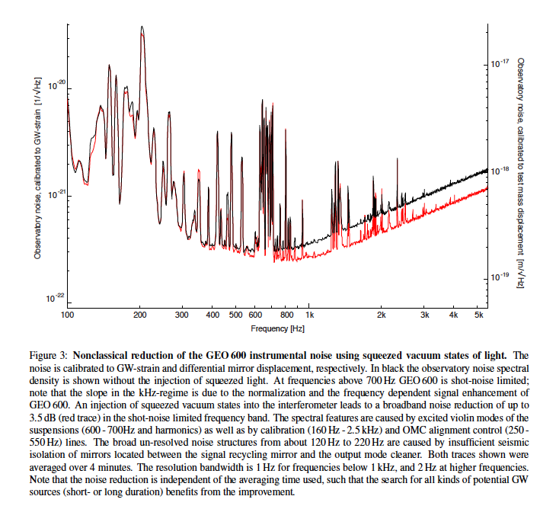
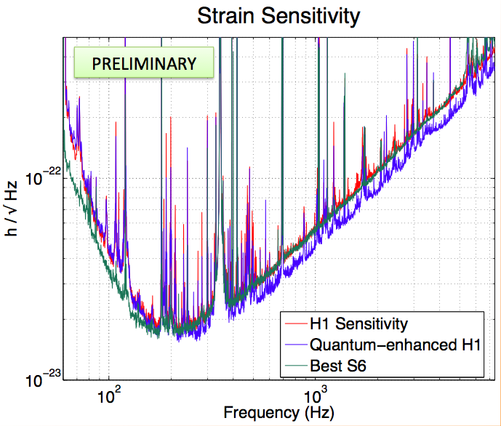
Squeezed Detectors

Slide 14
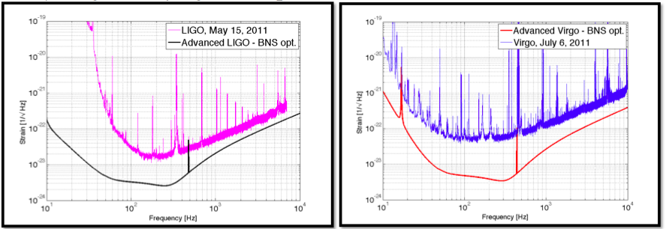
Advanced LIGO/ Advanced Virgo
~10 times better, lower frequencies in band
Installation in progress

Slide 15
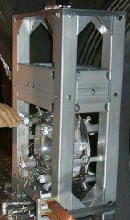
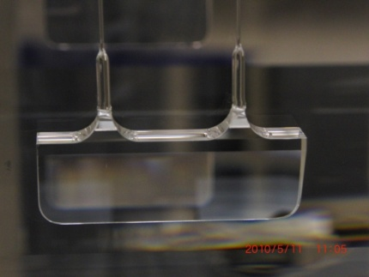
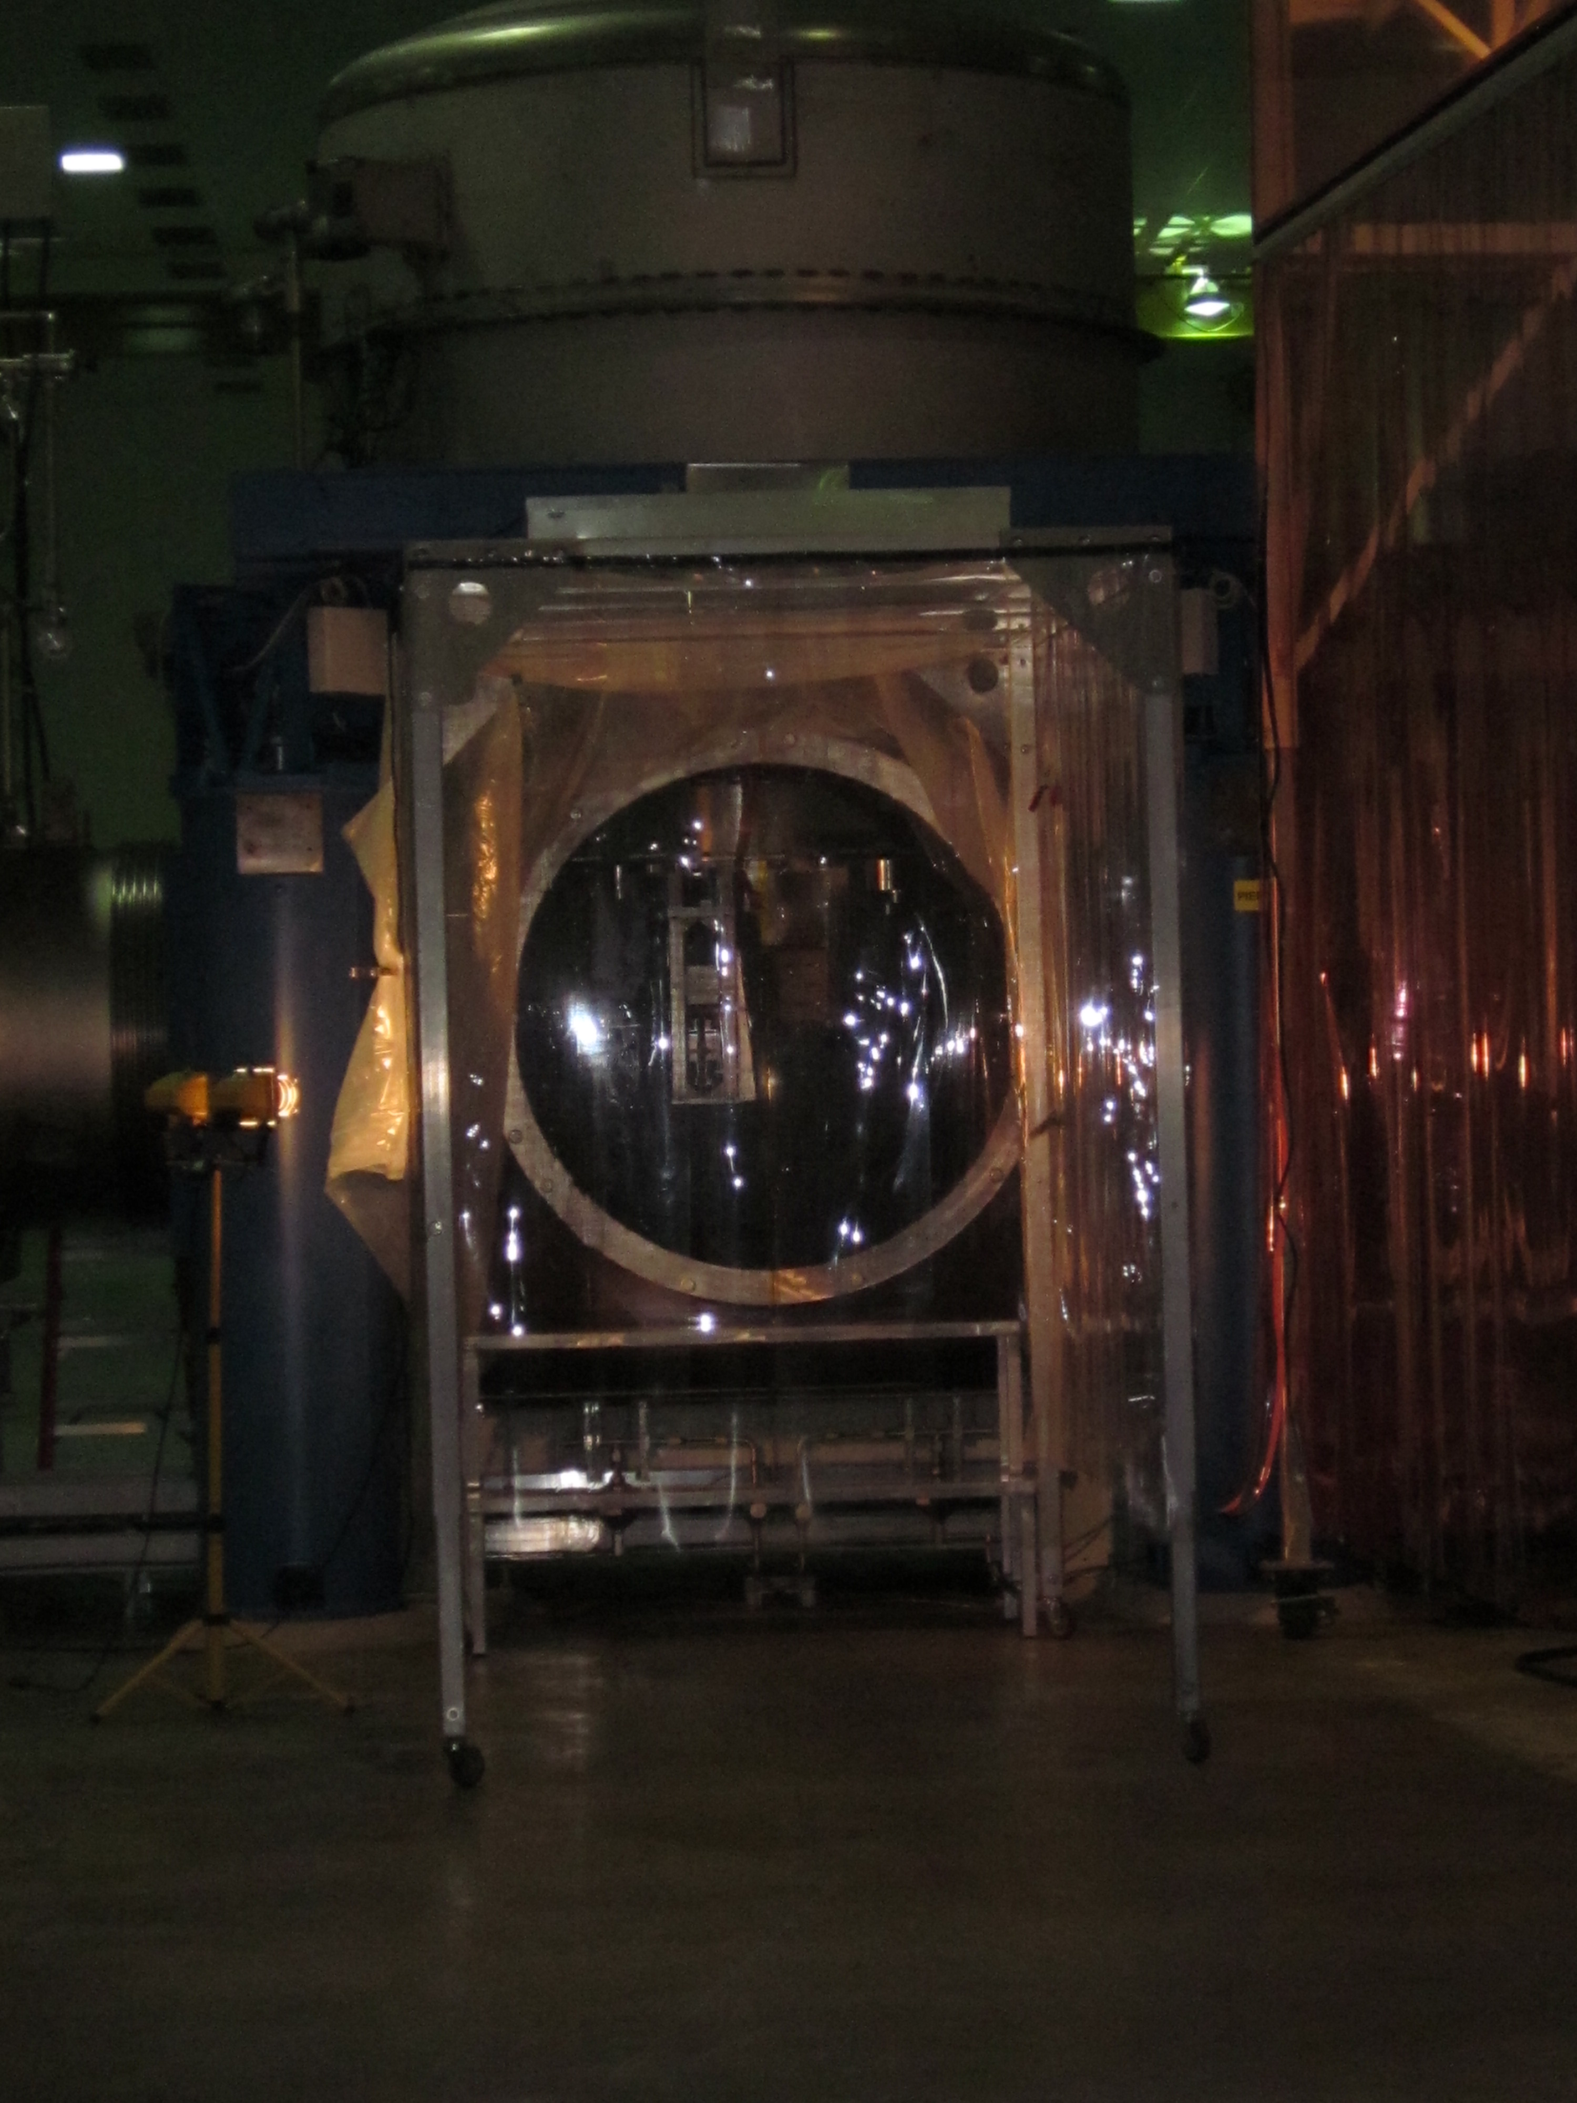
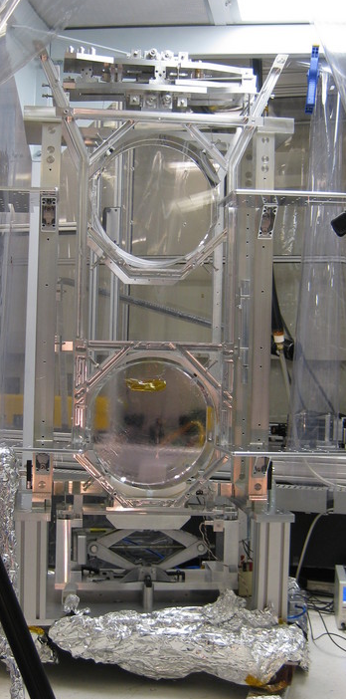
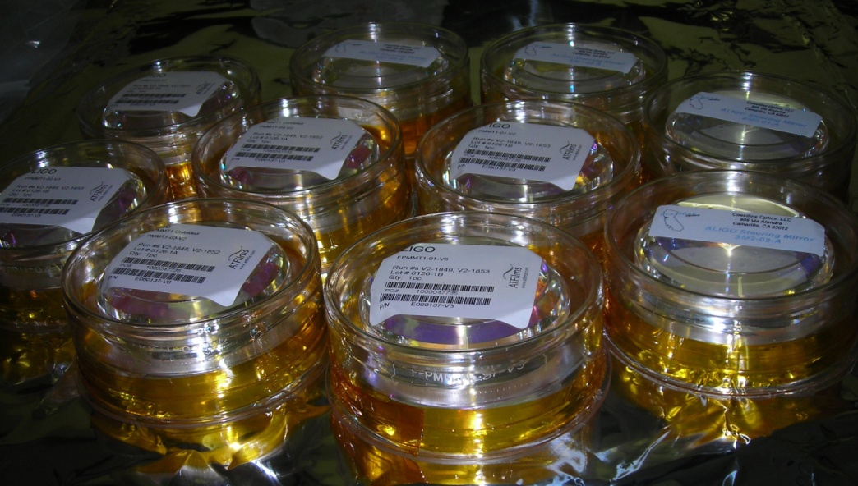
Initial vs Advanced LIGO
Simple pendulums become
monolithic, quadruple pendulums
with better quality optics
Prototypes being tested,
optics are polished

Slide 16
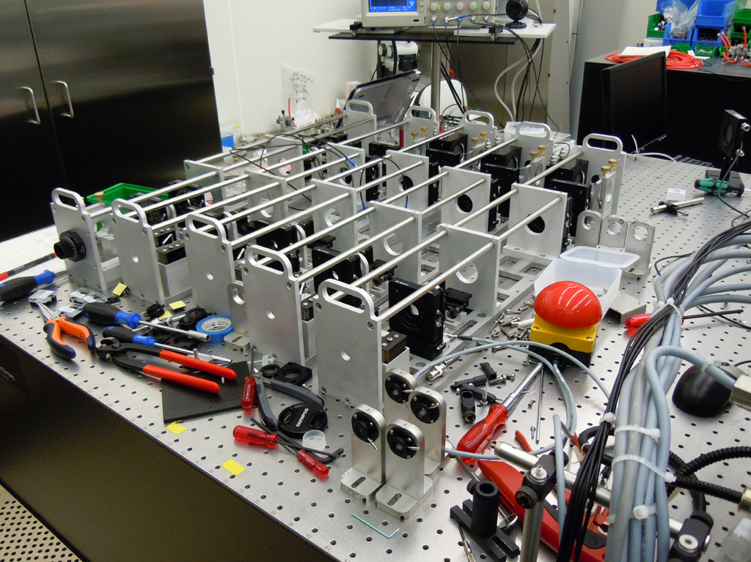
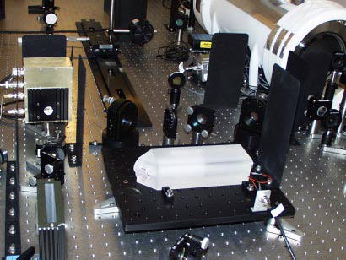
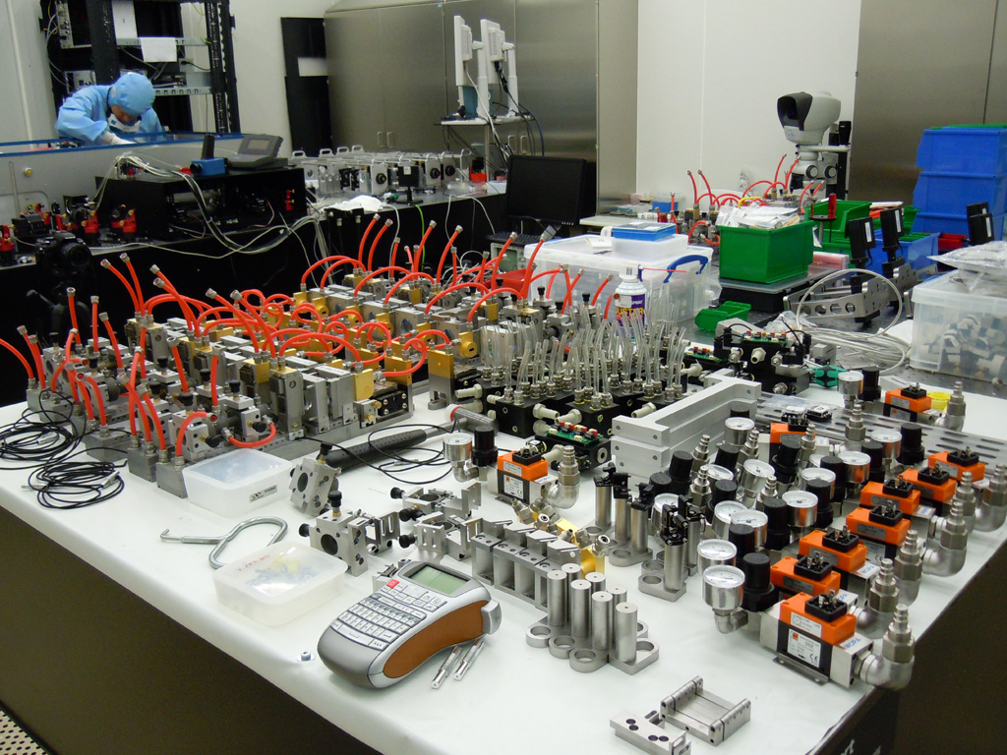
Initial vs Advanced LIGO
Lasers become more powerful: 10W ➔ 200 W
Installed and being tested at LIGO Livingston.

Slide 17
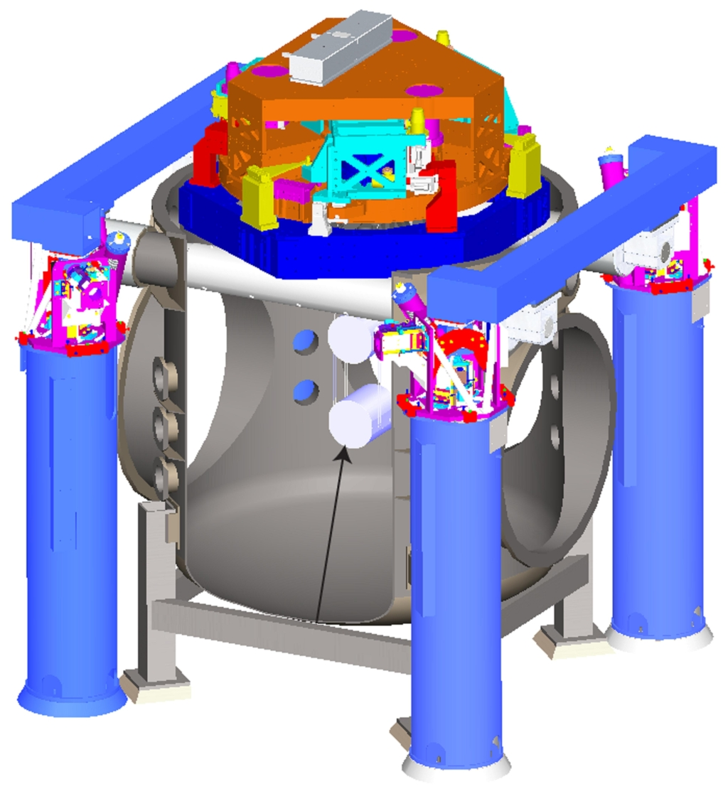
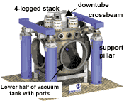
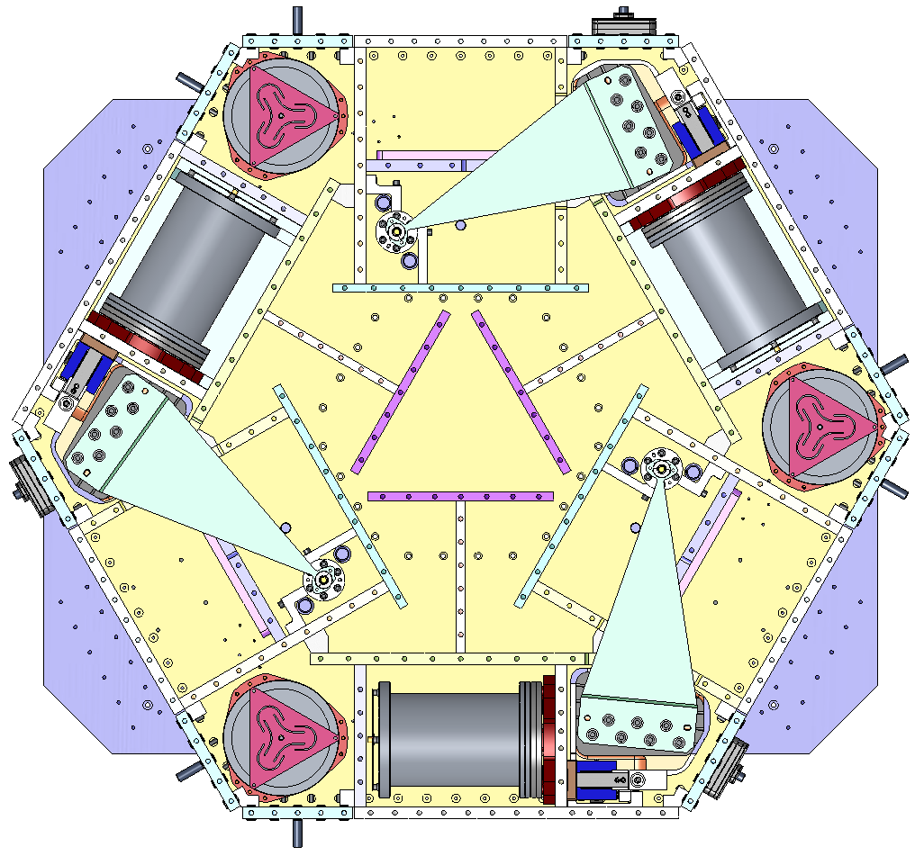
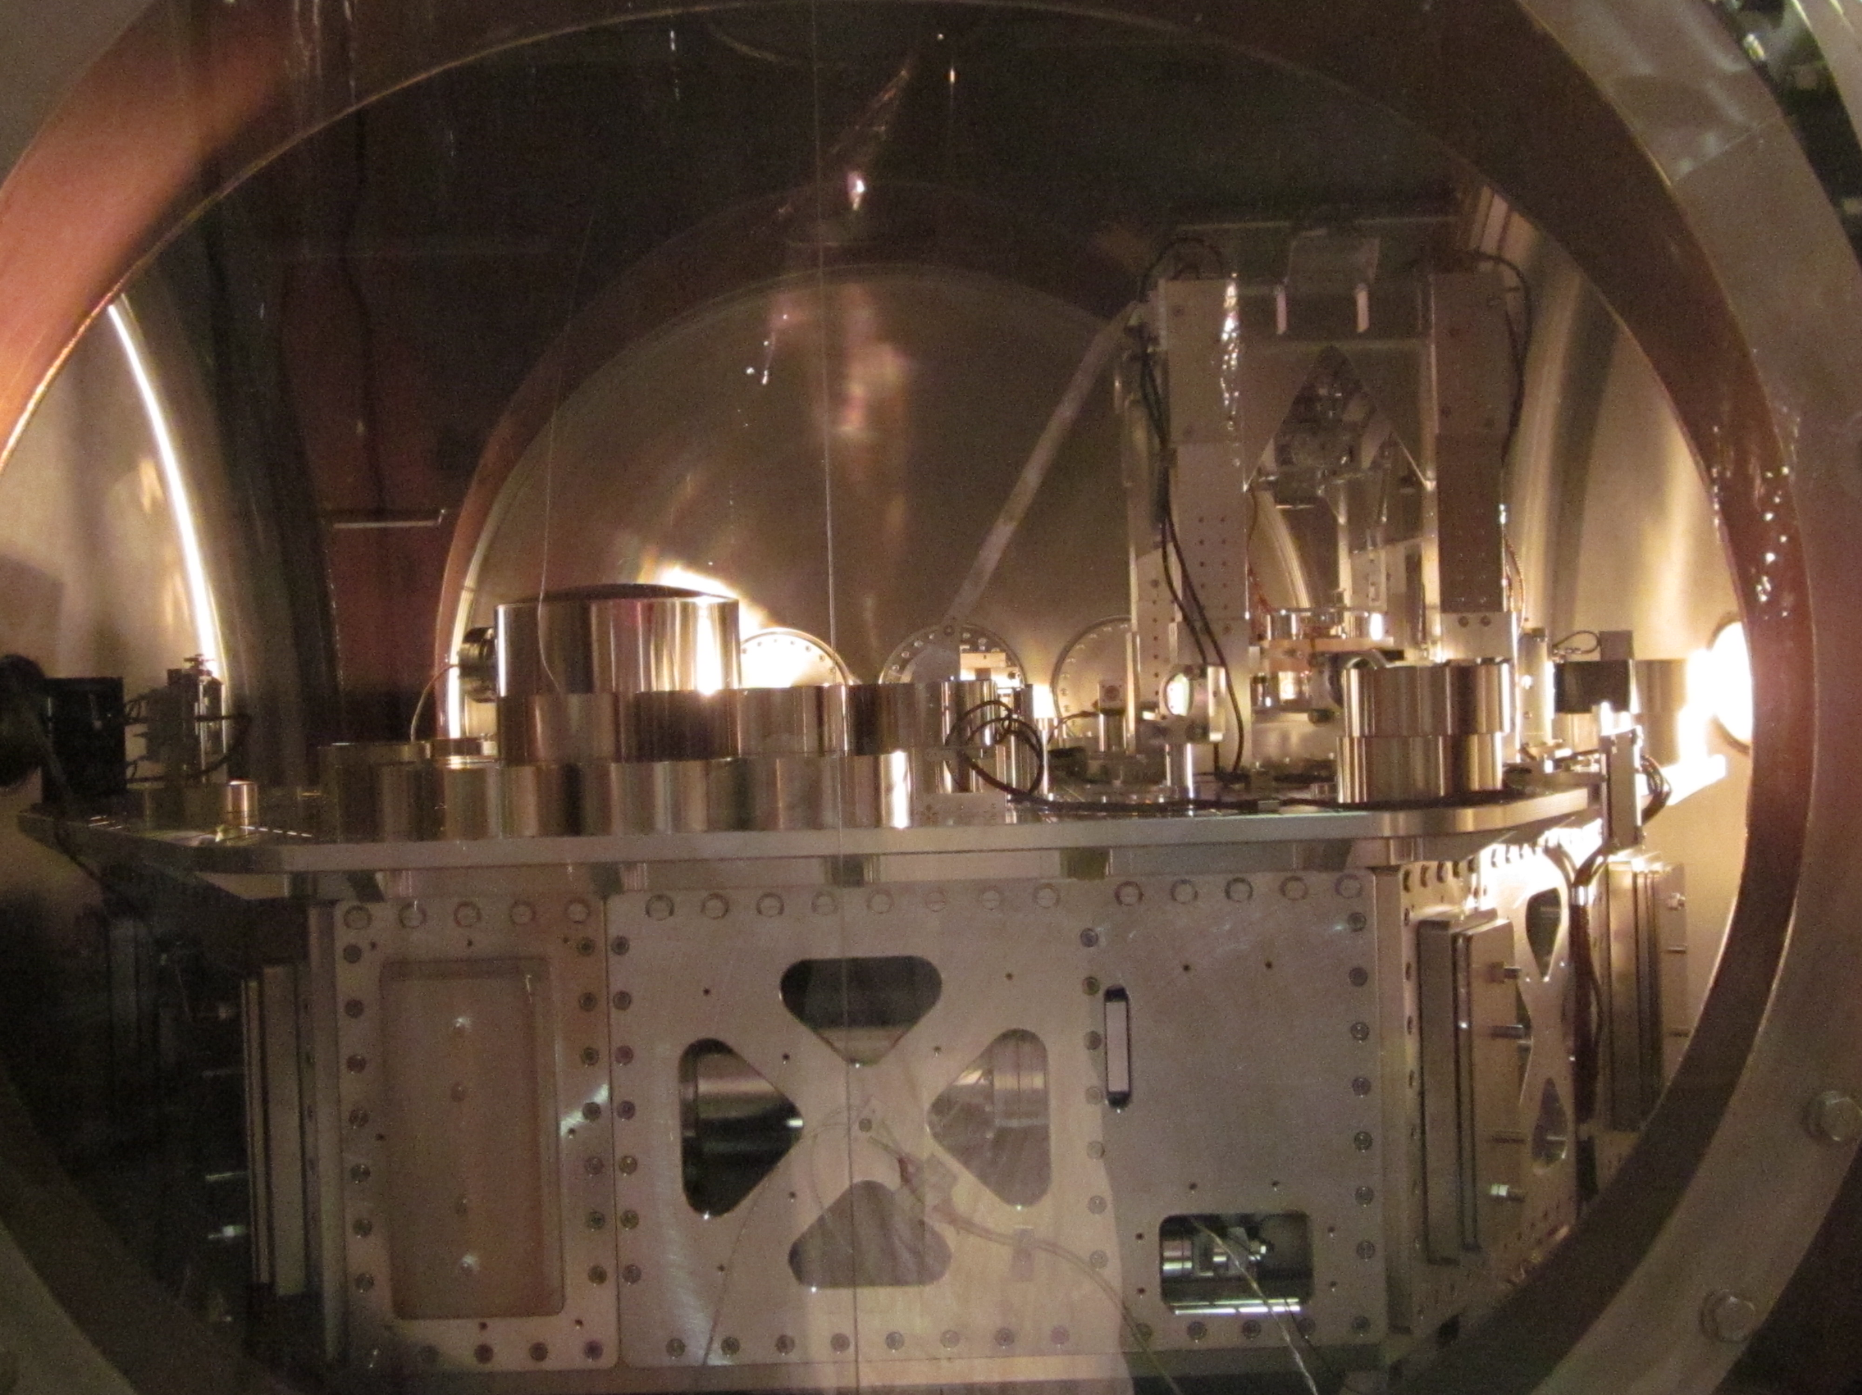
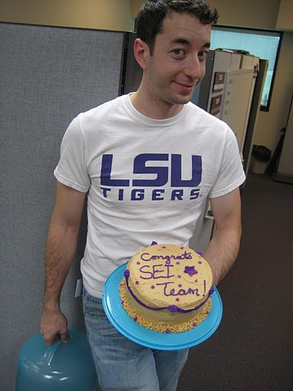
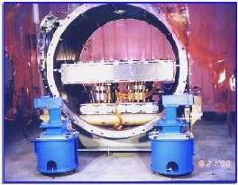
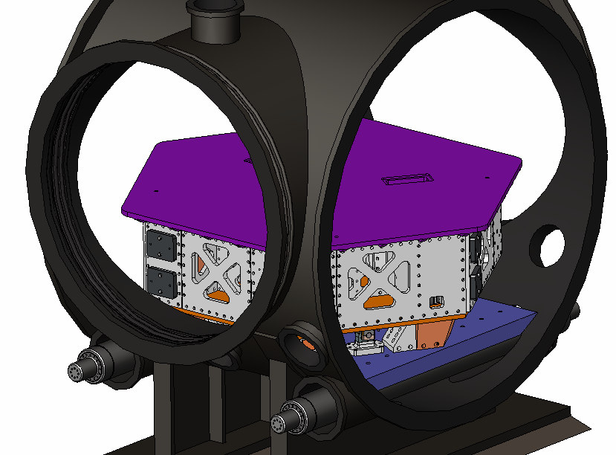
Initial vs Advanced LIGO
Seismic isolation goes from passive to active
HAM SEI tested in S6
Most chambers have now their “SEI” installed.

Slide 18
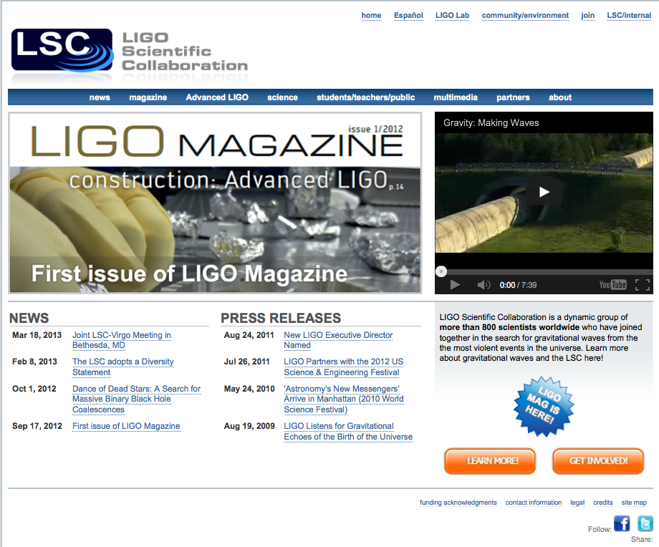
More on Adv LIGO:
LIGO magazine in www.ligo.org

Slide 19

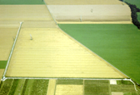


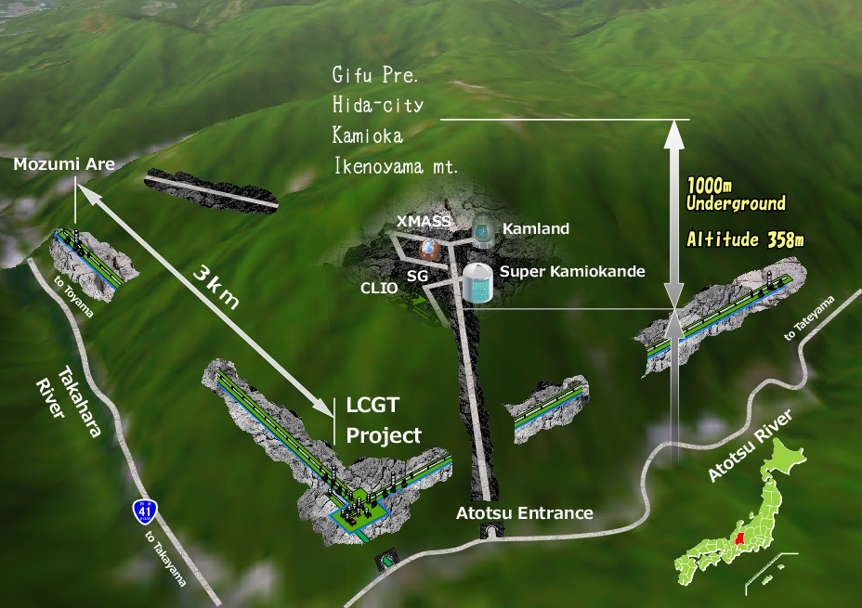

The Advanced GW Detector Network~2020
Advanced LIGO
Hanford
GEO600
Advanced
Virgo
KAGRA
Advanced LIGO
Livingston
LIGO-India?
19

Slide 20
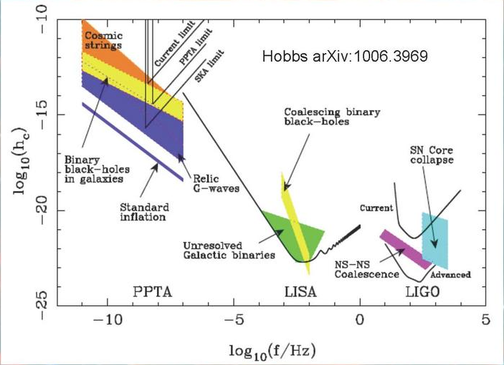
Other GW detectors

Slide 21
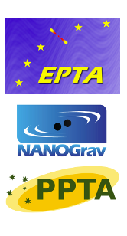
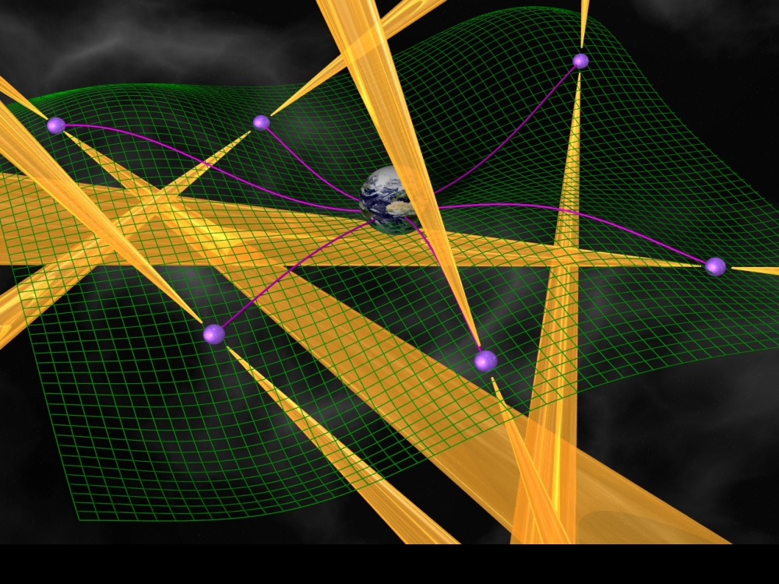
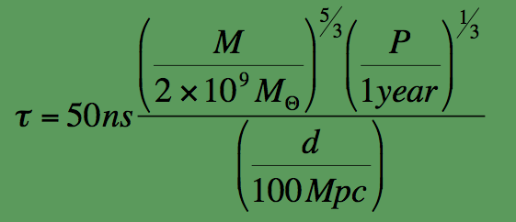
Pulsar timing arrays
Image Courtesy of Michael Kramer
Nanograv residuals

Slide 23
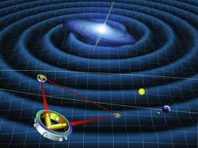
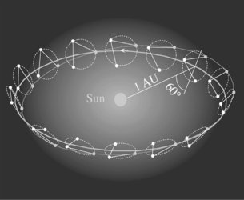
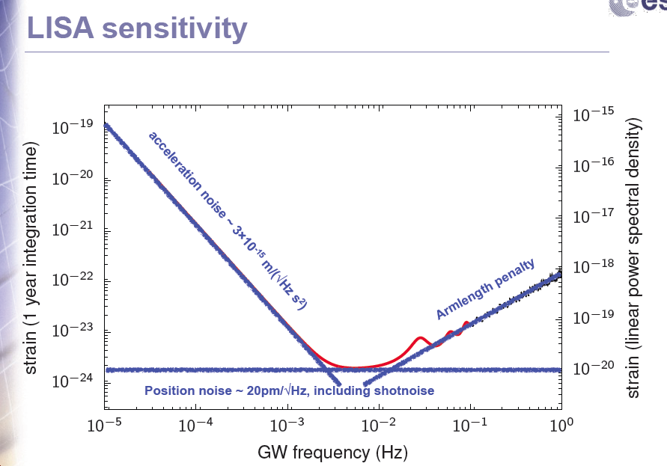
Space detectors: LISA

Slide 24
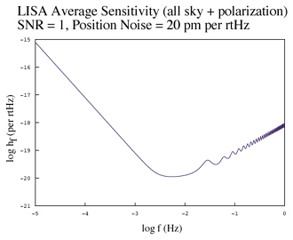
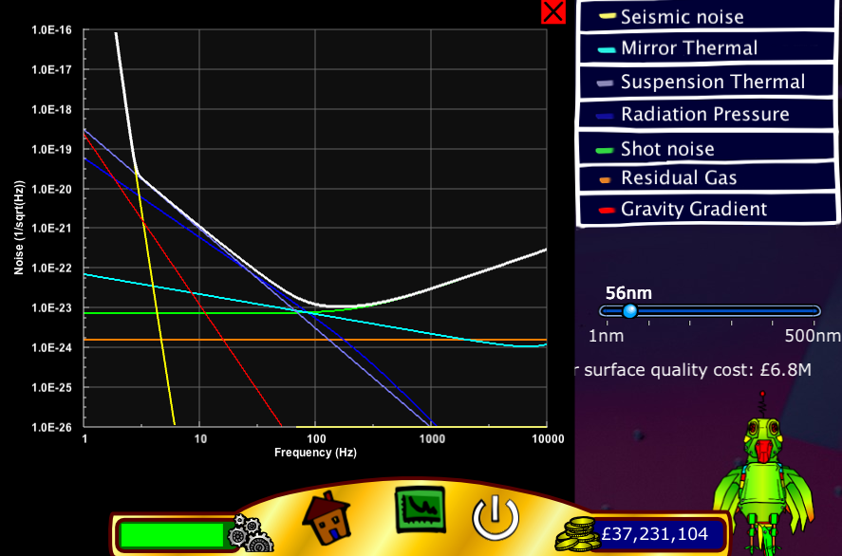
Online generators
http://www.srl.caltech.edu/~shane/sensitivity/MakeCurve.html
http://www.gwoptics.org/processing/space_time_quest/

